Slide 1

Thank you for your interest in this training module.
Turn your speakers on (there is audio).
Click "Slideshow" in the upper right corner of your screen to start the slideshow.
Use the arrows on your keyboard to move from one slide to the next.
Enjoy!
These slides will work best when using Google Chrome or Microsoft Edge.
Thank you!

Slide 2
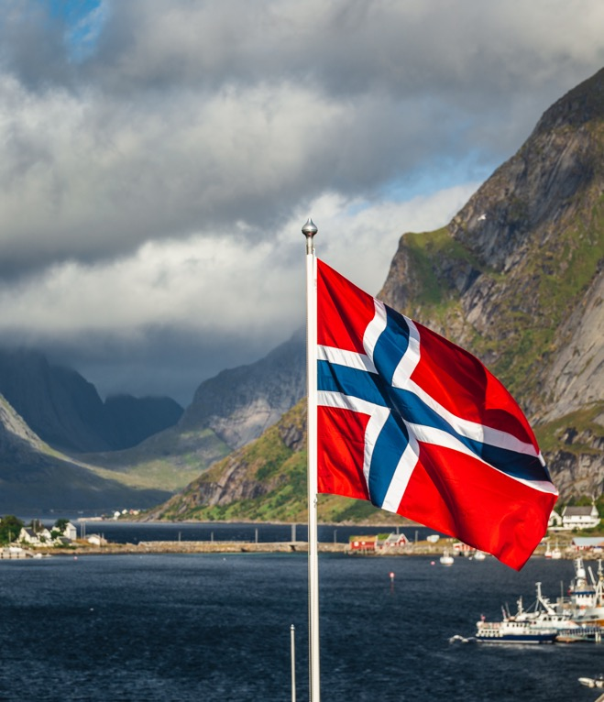
Local Lodge Training
2024

Slide 3
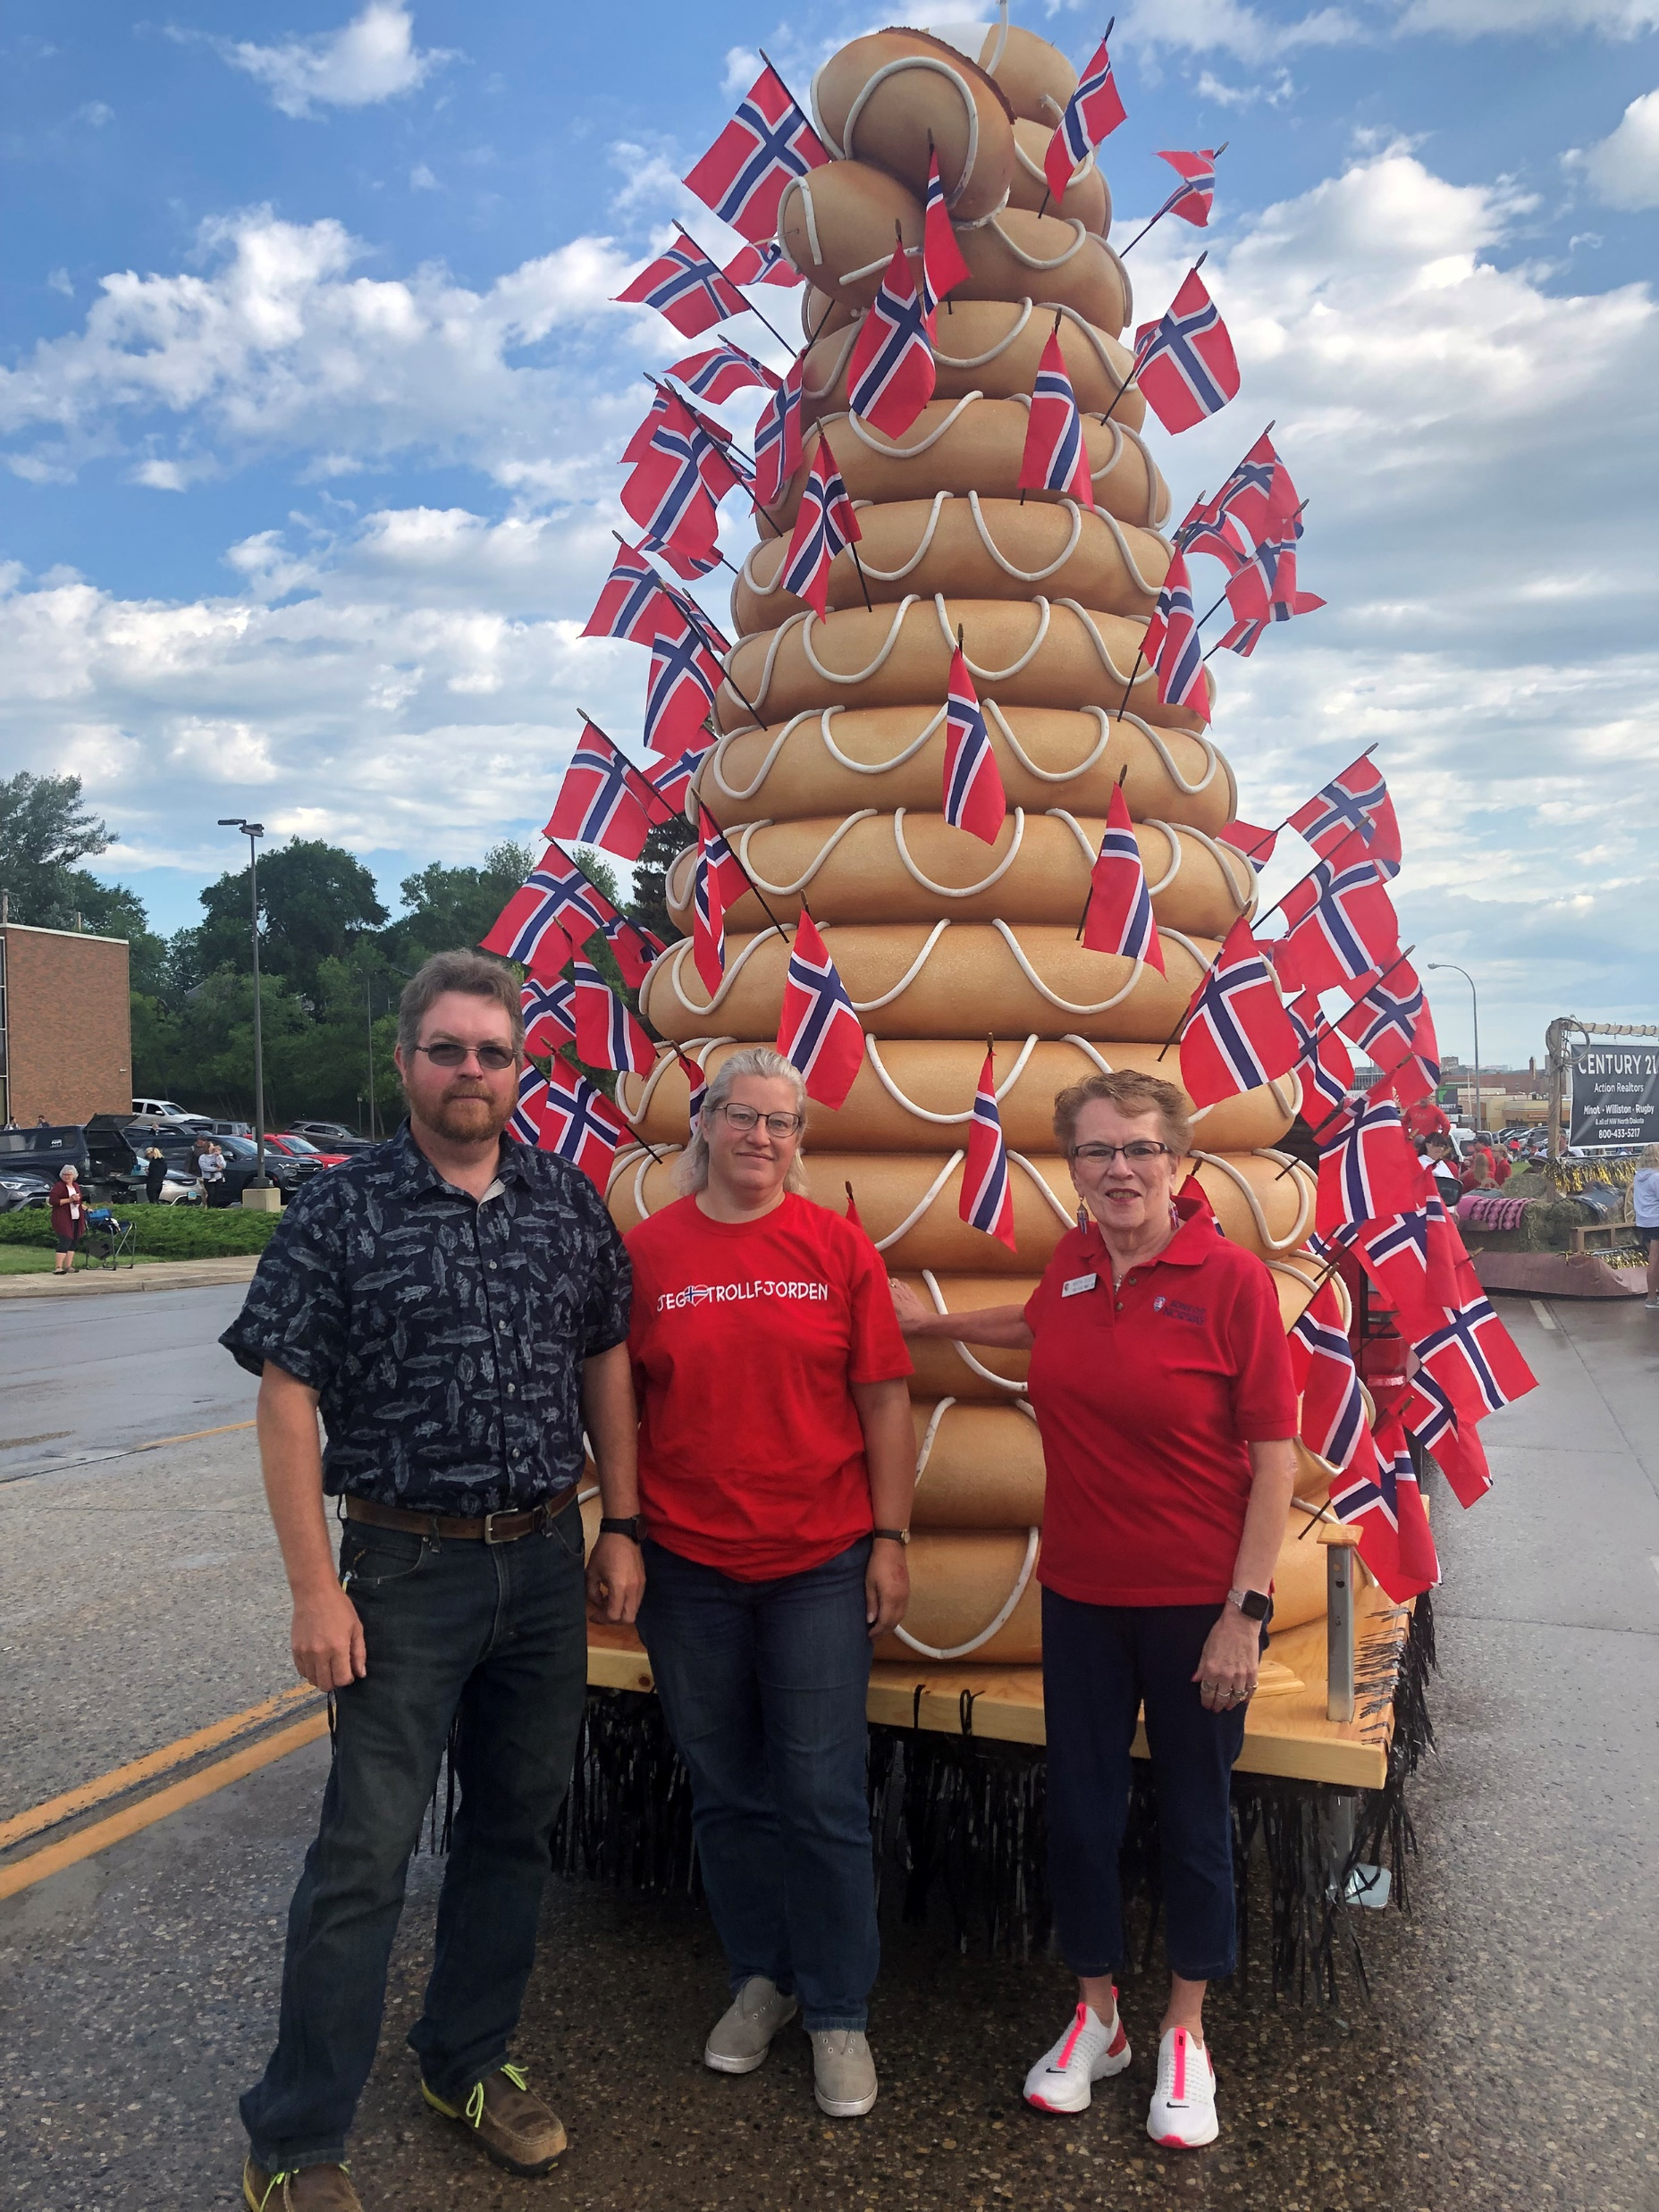

Welcome!
Introduction
Multiple training modules
Independent, online training
Aim to educate and inform you
Each lodge is unique (that’s what makes it special!)

Slide 4
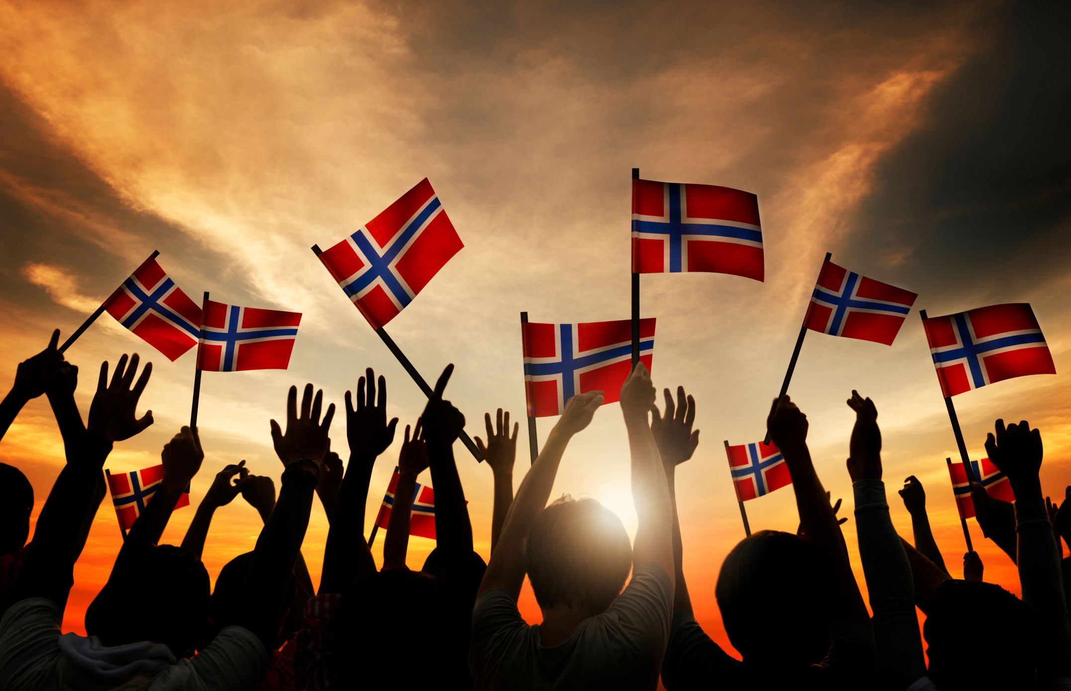
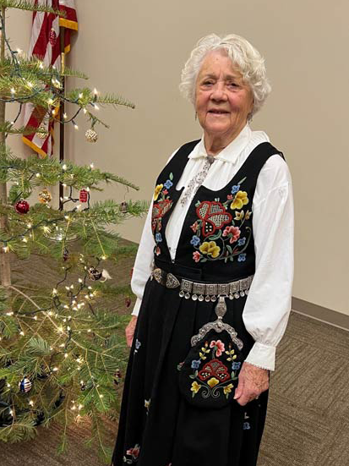
Module Objectives
Module Objectives
How does the local lodge fit into the district?
How does the district fit into Sons of Norway International?
Roles and responsibilities for leaders.

Slide 5
Mission
At Our Core
The Sons of Norway Mission
The mission of Sons of Norway is to promote and to preserve the heritage & culture of Norway, to celebrate our relationship with other Nordic Countries, and to provide quality insurance and financial products to its members.

Slide 6
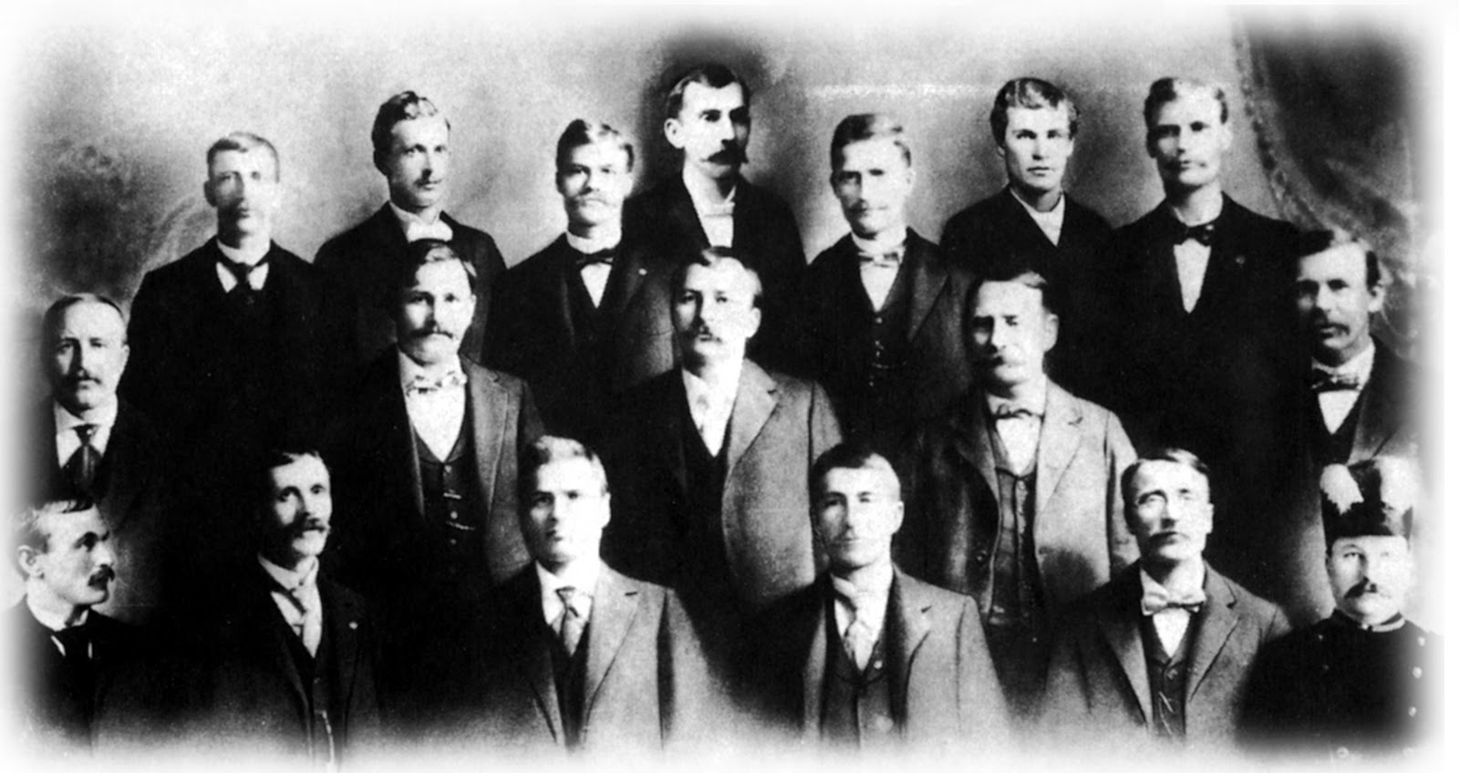
Mission
At Our Core
Founded in 1895 by 18 Norwegian immigrants who wanted to protect one another in a new world.
They pooled their resources to help guard against the hardships that come with starting a new life.
Through banding together and sharing resources, they founded the basis for our fraternal and insurance organization that still exists and protects families of all backgrounds 125 years later.
Aim to promote and preserve the heritage and culture of Norway and provide insurance and financial products to our members.

Slide 7
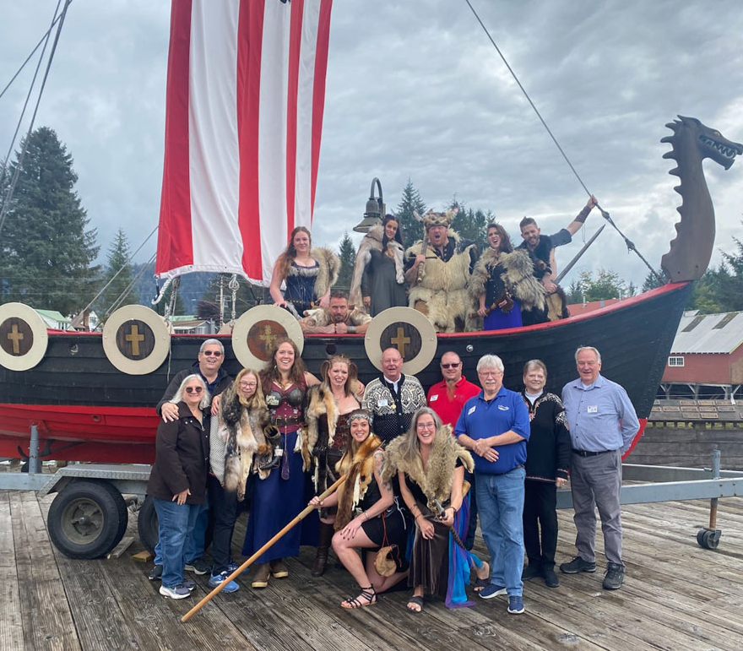
Mission
Today….
Staying true to the mission, Sons of Norway focuses on three core business areas:
Financial products
Foundation
Fraternal

Slide 8
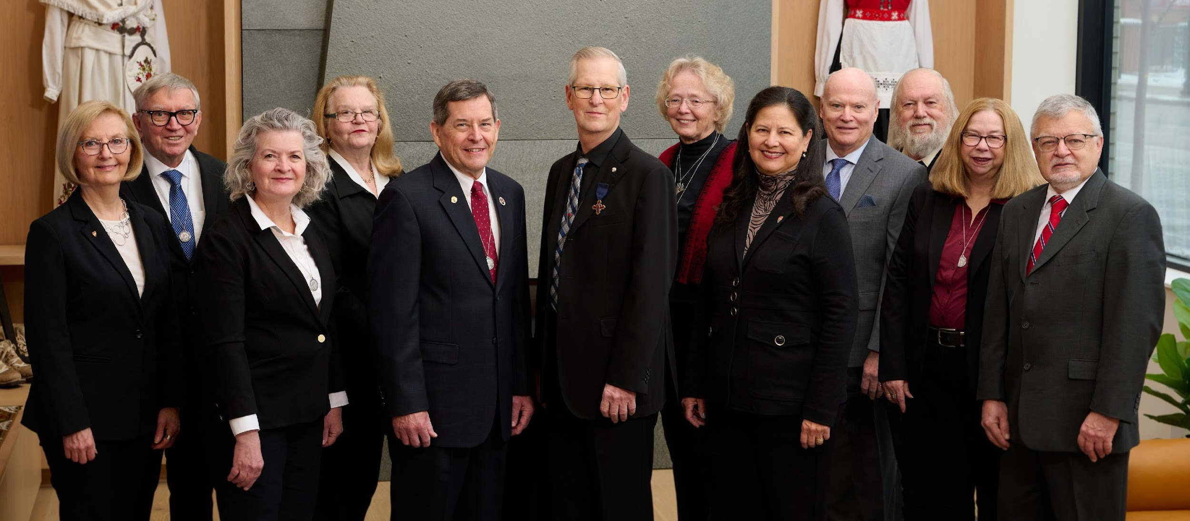
Structure
International Board
The International Board (IBOD) consists of:
Four executive members
Eight representatives
A legal advisor
An insurance advisor

Slide 9
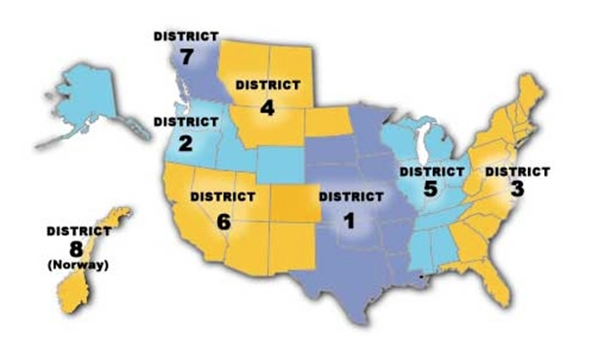
Structure
Districts
There are 8 regional districts covering Canada, Norway and the US.
Each district has a set of district officers including but not limited to: President, Vice President, Secretary, Treasurer. Each district is also represented by an International Director on the International Board. These important roles help guide the success of the organization at each level.
District Conventions happen every two years. Business is conducted there to set priorities for the district.

Slide 10
Structure
Zones
Each of the eight districts is divided up into zones
Zones vary by number of lodges and geographic area
Each zone has a leader and is a great first resource for lodge leaders – get to know yours!

Slide 11
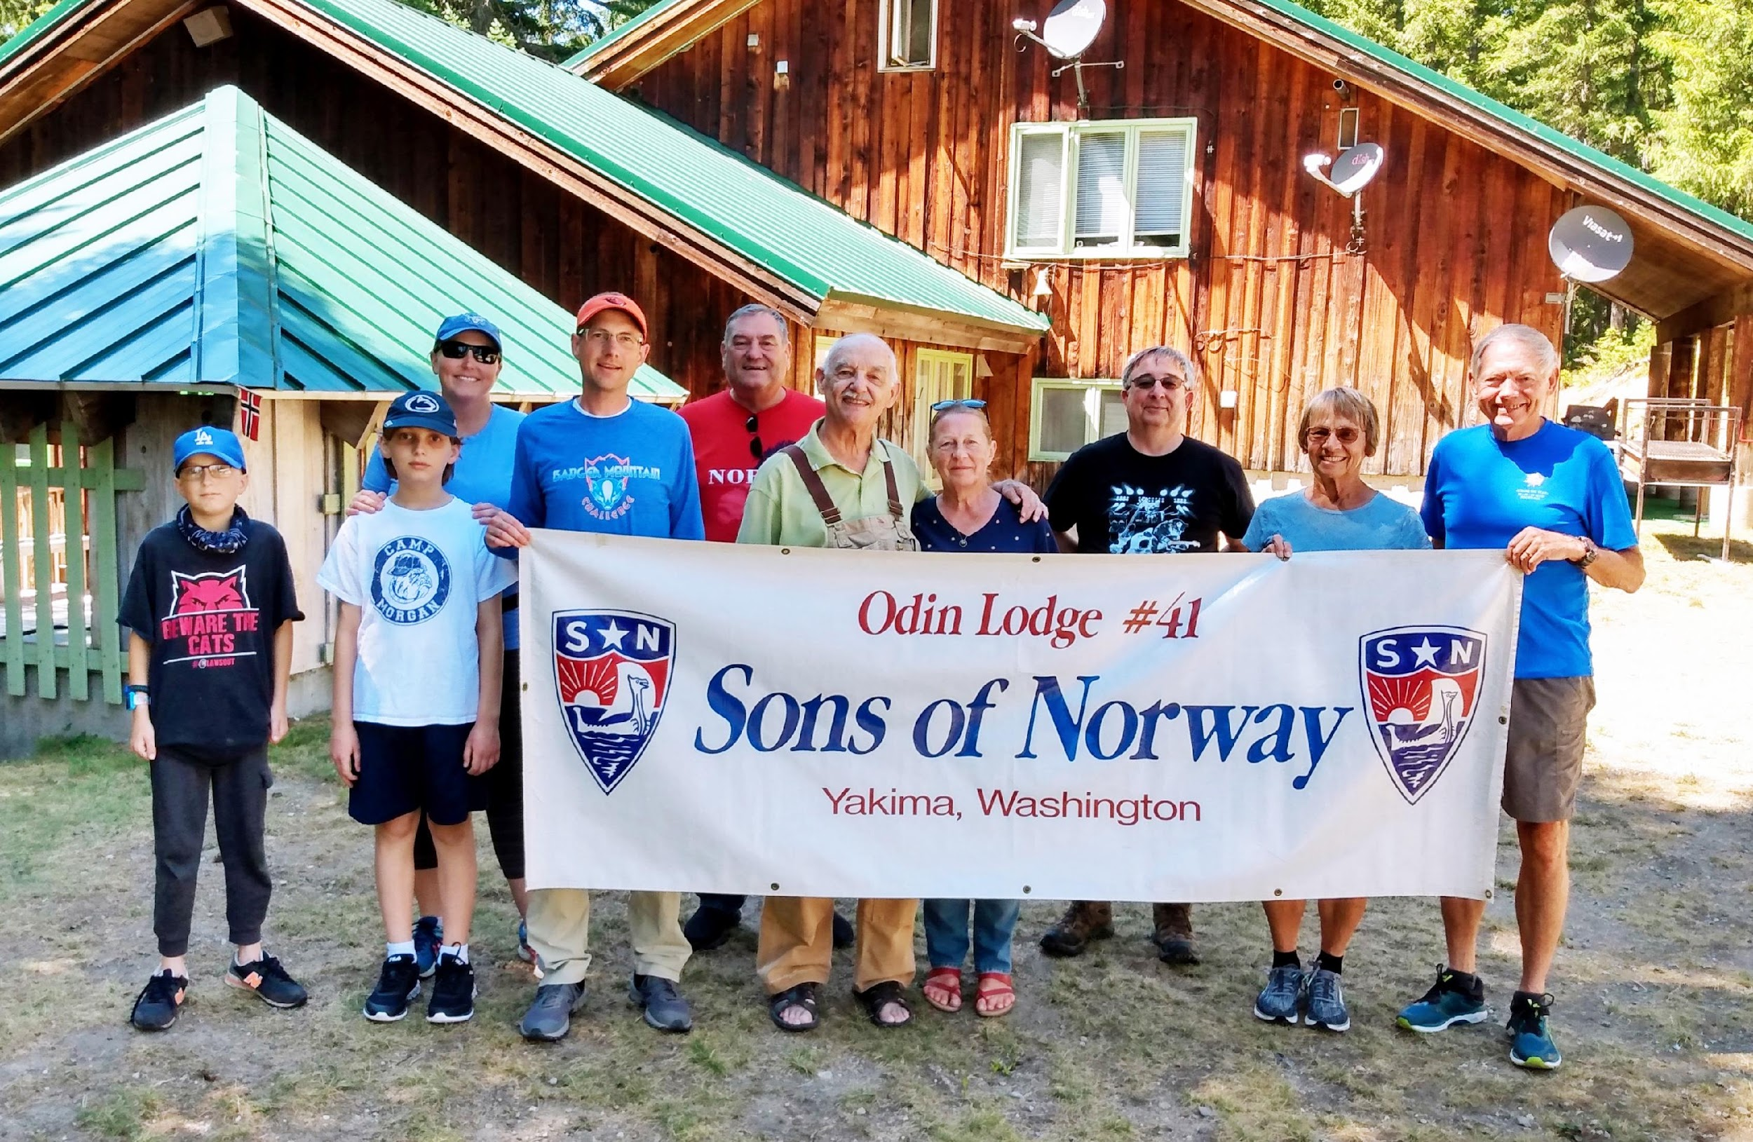
Structure
Lodges
There are nearly 300 lodges in Canada, Norway and the US
Lodge leadership requires a minimum of 4 individuals: President, Vice President, Secretary and Treasurer
Other lodge officers are key to the success of a vibrant lodge and may include Membership or Financial Secretary, Social Director, Cultural Director, etc. (Certain roles may be shared)
Every lodge is unique so structures may vary

Slide 12
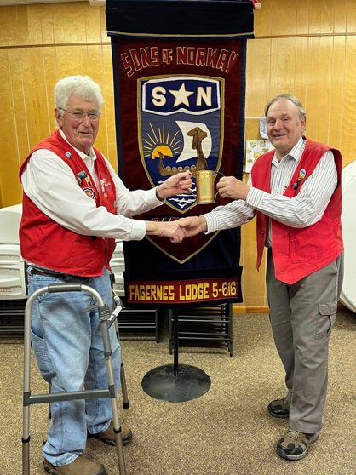
Lodge Details
Local Lodge Details
Local lodges operate under their unique by-laws and mission statement – but must adhere to the Sons of Norway Charter, By-laws, Policies and Procedures (CBPP) as well as any District by-laws to fit within the Sons of Norway structure.
Lodges are fiscally independent with reporting due to HQ.
Lodges each manage their own events calendar.
Lodges manage welcoming new members and recognizing member milestones and achievements.

Slide 13
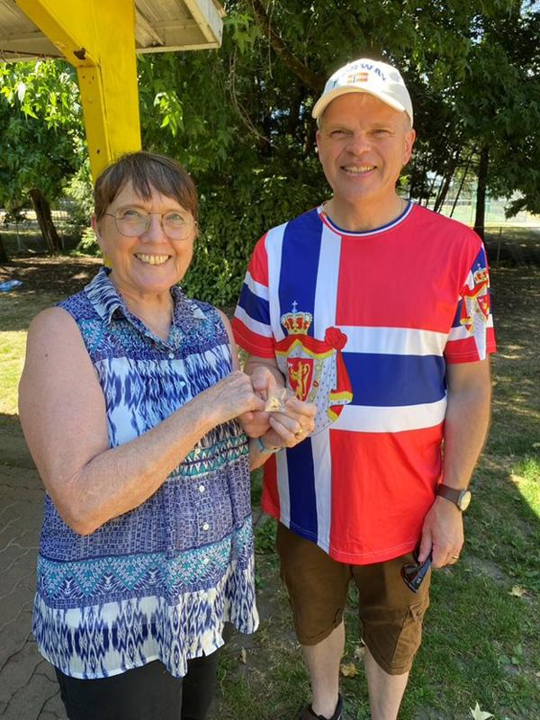
Meetings
Gather in Community
Local lodge meetings are an opportunity to make connections and build community to honor the Nordic culture and heritage.
Lodges must meet at least eight times annually. At least four times a year, a closed business meeting must be held.
Social meetings do not need to happen only at the lodge’s regular meeting location – go out and explore!
It’s important to follow the guiding principles of the lodge and operate as such.

Slide 14
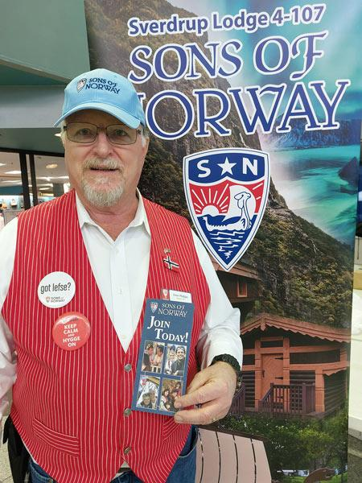
Meetings
How to Conduct a Meeting
Lodge president presides at all lodge meetings
Robert’s Rules of Orders shall be the recognized parliamentary authority at lodge meetings
Minutes should be kept of all business meetings and made available to members
Social meetings do not need to follow formal procedures

Slide 15

Meetings
Potential Meeting Agenda
Lodge President calls meeting to order
Members stand as flags are presented and all 3 national anthems are sung
Officer reports and communications are read
Guests are welcomed
Honors and awards are presented
New members are welcomed
Unfinished business is discussed
New business is presented and discussed
Closing announcements
Meeting adjourned

Slide 16

Reporting Requirements
Important Dates
Link to website: Important Deadlines | Sons of Norway
January 15
International Scholarship applications to Foundation
February 15
Domestic Scholarship applications to Foundation
March 15
D17 financial form from each lodge
Lodge Achievement & Family Lodge of the Year surveys
AFA Reporting of Community and Fraternal Activities
D64 Lodge Property Officer updates

Slide 17
Reporting Requirements
Important Dates
May 15
D18 property association financial form (if a lodge has property)
IRS filing deadline for tax form 990. Lodge Treasurer needs to notify HQ when 990 is submitted
Fall
Lodge Liability Insurance, covers all lodges but expense shared between lodges with more than 25 members. Invoice sent to Treasurer in the fall.
December 31
D63 Lodge Officer Updates
Applications for Foundation grants

Slide 18
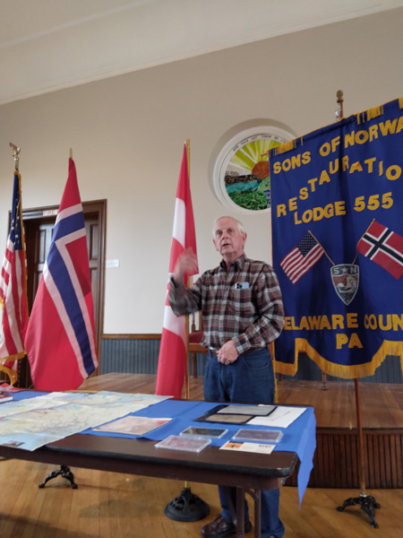
Duties as a Leader
Important to Understand
Understand your role
Understand your rights
Understand your responsibilities
Duty of loyalty
Duty of obedience
Personal liability

Slide 19
Code of Ethics
To the Members and Others
Confidential information
Gifts to and from members and others
Avoid conflict of interest
Avoid even the appearance of impropriety
Do not offer legal or tax advice

Slide 20
Code of Ethics
To the Sons of Norway
Respect Sons of Norway property and confidential information
Recording and reporting information
Use of Sons of Norway funds and assets for legitimate business purposes
Maintain complete and accurate accounting records
Code of Ethics everyone signs annually

Slide 21
Privacy Policy
Important Reminder
The policy explains what information is collected, how it is used and how it is protected
Membership lists and reports are strictly confidential
Never share personal, medical or financial information for any purpose other than approved Sons of Norway business
Use great care to prevent unauthorized use of information
Privacy Policy | Sons of Norway

Slide 22

Social Media Policy
Social Media Policy Highlights
Policy can be found on the website: Link to the Social Media policy
Follow Sons of Norway policies, be professional and honest
Neither members nor officers are authorized to speak on behalf of the organization, that is managed at Headquarters
Respect copyright laws
Remember, the internet does not forget

Slide 23
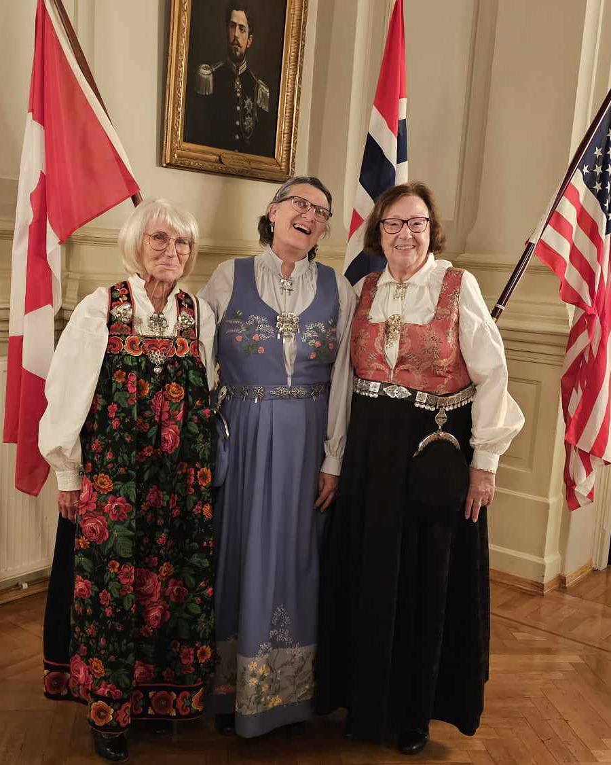
New Lodge Formation
Lodge Formation
New lodges require a minimum of 25 members to form
New Lodge Organization Guides are available from Membership Services and include paperwork required to the District President
Organizational members host a series of informational meetings, culminating with the Institutional Meeting, a celebration of a new Sons of Norway lodge
Lodge charter remains open 60 or 90 days after the Institution
New-Lodge-Checklist-.pdf (sofn.com)

Slide 24

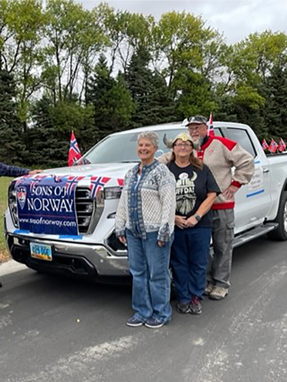
Lodge Mergers
Two Types of Mergers
Formal mergers occur when the government of two lodges join together to create a completely new lodge. This lodge can retain the name of one lodge and member number of the other or a new lodge name can be created.
Informal mergers occur when a lodge disbands, and all the members transfer together into another local lodge. The disbanding lodge’s name and number is then retired.
Fraternal can offer advice with this process

Slide 25
Lodge Dissolution
Lodge Dissolution
Lodges considering disbanding should contact Headquarters for procedures.
To disband, a lodge must hold a series of two meetings, as they would for bylaws change.
If a lodge votes to disband, the following items are to be returned to Fraternal: D17 Financial Statement up to the date of the vote, Official Notification of Lodge Disbandment, Disbursement of Funds and the original lodge charter (if available).

Slide 26
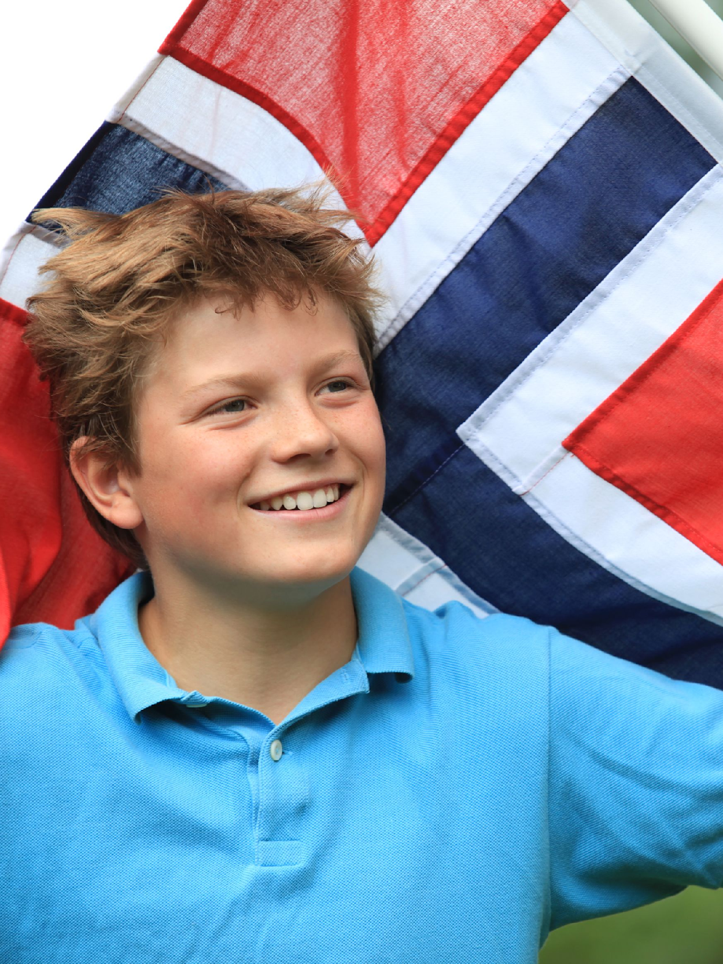
Record Retention
Keep or Toss?
Record retention is important to lodge and membership business, so organize early and have a system
Store documents responsibly, especially if it has private information
Items to keep in perpetuity include:
Lodge charter
Lodge bylaws
Lodge or District building association’s records
Find the Leadership Video on this topic on the website

Slide 27
Resources
Resources Available
Best resource: www.sofn.com
Charter & By-Laws/ Policies & Procedures
Utilize your District website
District and Zone leaders are also a good resource
Fraternal at HQ can answer questions at fraternal@sofn.com or 1-800-945-8851 and select #6 for Officer Support
Notes:
As a leader, if you are still unsure about how to proceed on something or need clarification, there are always resources available to you. Make sure to utilize all of them.

Slide 28
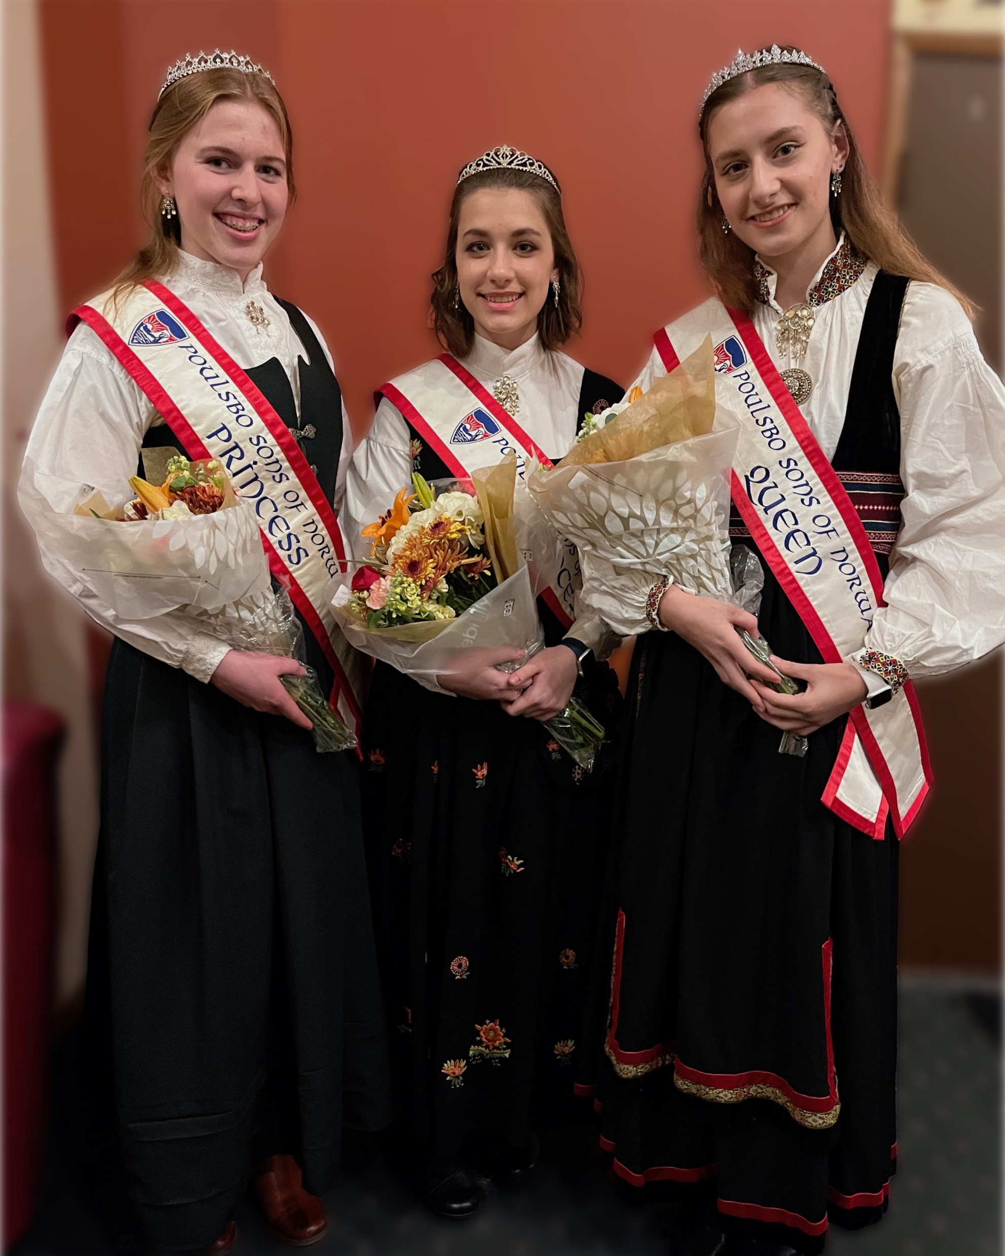
Reporting Requirement
Lodge Achievement Form
The Lodge Achievement Form highlights how a lodge is succeeding in the areas of:
Promotion and Recruitment
Member Experience
Administration
Financial
Foundation
It awards a score (out of 100) that districts use to determine Lodge of the Year awards during conventions.
Submitted through Survey Monkey on the website by the secretary usually.

Slide 29
Reporting Requirement
Family Lodge of the Year
The Family Lodge of the Year program honors outstanding lodges that provide opportunities for family participation
Awards are determined by points tallied from online submission form, due by March 15
Typically submitted by lodge secretary
F

Slide 30
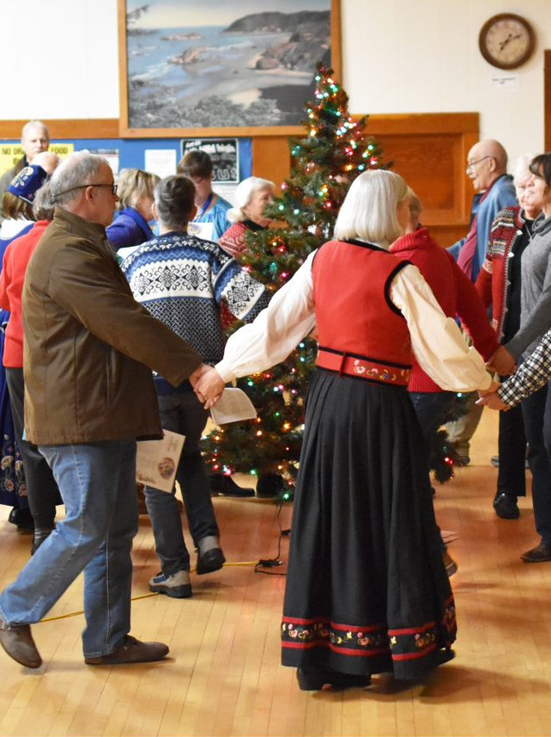
Reporting Requirement
AFA Year End Reporting
AFA stands for American Fraternal Alliance
This required reporting helps us report community service and fraternal activities that advance the mission of Sons of Norway
Track community and fraternal events
Track the hours spent working on events and lodge activity
Completed with Survey Monkey through the website

Slide 31
Reporting Requirement
AFA Year End Reporting
Tracking Volunteer Hours:
While the AFA only requires that we report the
information for US lodges, we strongly encourage our Canadian and Norwegian lodges to track their hours and events.
WHY?
Lodge Achievement Form
Marketing, Advertising, & Recruitment
Donor Appeal
Grant Opportunities

Slide 32

Reporting Requirement
D-17
The annual requirement gives a picture of the financial position of each lodge
The D-17 is a required report by March 15. Lodge Treasurers can file electronically from their profile page. Three signatures are required.
This Leadership Video may be helpful, or your District Treasurer, or email fraternal@sofn.com

Slide 33
Reporting Requirement
D-18
The annual requirement is required to be submitted by all lodges that own property.
The D-18 is a required report due by May 15. Lodge Property Treasurers can file electronically from their profile page. Three signatures are required.
It is important to let your district and HQ know if you have sold property.

Slide 34

Reporting Requirement
Form 990
It is an IRS requirement for each lodge to file Form 990
Due date is May 15
Failure to do so for three years will end the lodge’s tax-exempt status.
Extensions are an option with Form 8868
Use the IRS website at IRS.gov

Slide 35
Reporting Requirement
Form 990-N
For organizations with annual gross receipts of $50,000 or less, use the Form 990-N (the e-Postcard) by May 15
Help resources:
login.gov
https://www.irs.gov/pub/irs-pdf/p5248.pdf
877-829-5500

Slide 36

Reporting Requirement
D-63 and D-64 Officer Updates
The D-63 annual requirement is how lodges electronically report the new slate of lodge officers to HQ and is due by December 31.
The D-64 is similar except it’s for lodges that own property, like a lounge or camp, to update their officers to HQ. It is due March 15 and is also filed electronically.
These are important to keep accurate and updated so that the correct leaders are getting the information they need.

Slide 37
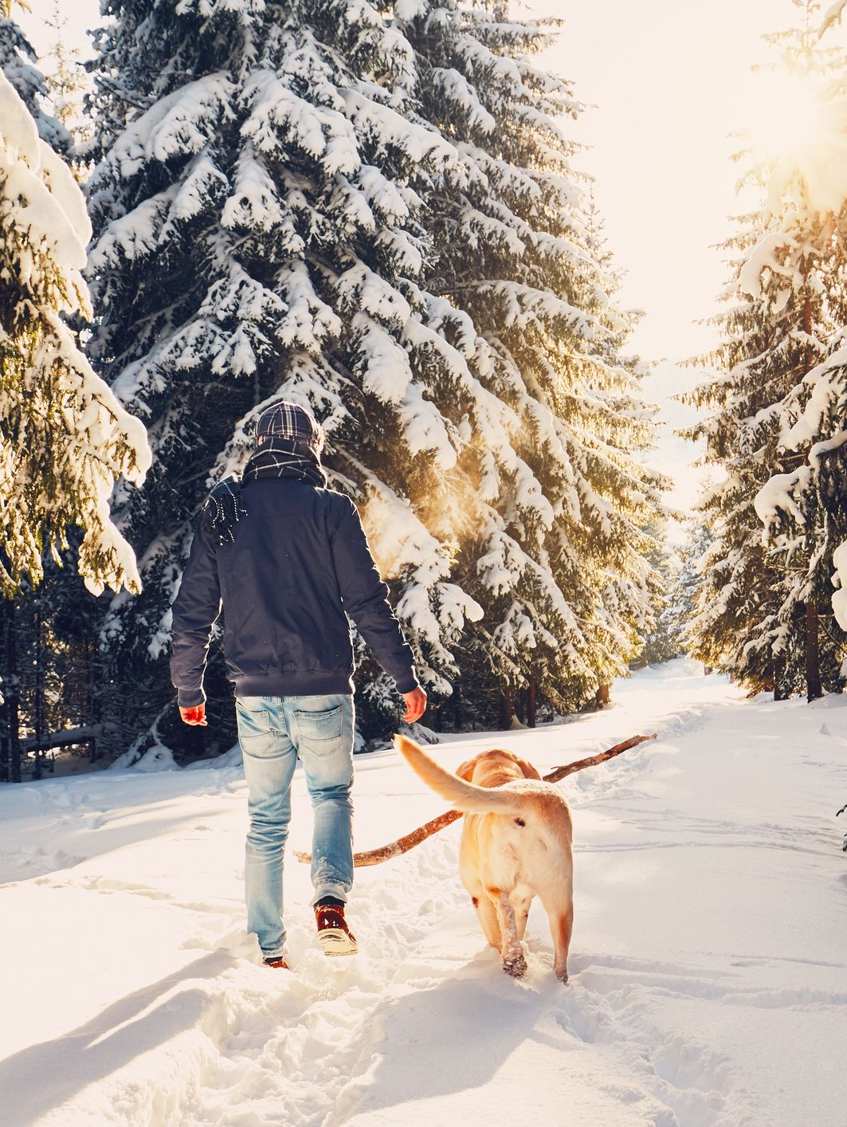
Sports Medal Program
Popular Engagement Tool
Lodge members enjoy the Sports Medal Program
5 different activities
Fitness, walking, swimming, biking, skiing
5 levels for each activity
A virtual pilgrimage

Slide 38
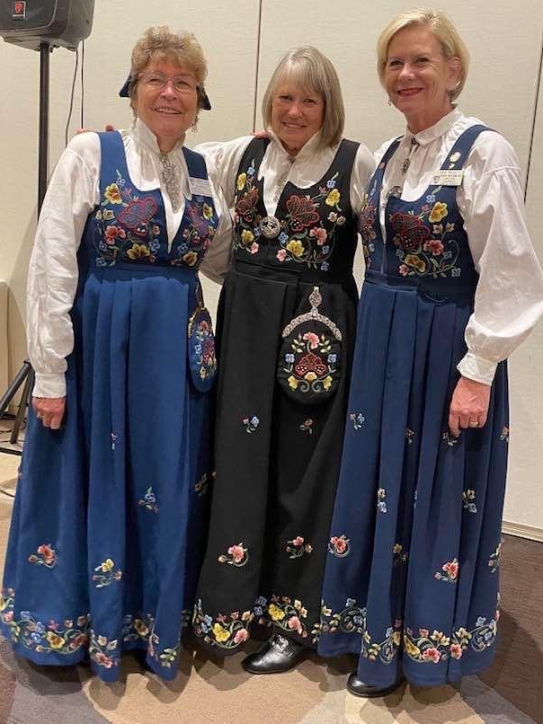
Cultural Skills Program
Also Popular
Cultural Skills program offers members a chance to connect with customs from Norway.
Topics include: wood carving, knitting, cooking, literature, stamps, rosemaling, genealogy, language, embroidery, figure carving, folk dancing, music, and chip carving.
Sons of Norway members love to earn pins!
Pins are ordered by lodge officers for skills and anniversaries by going to the Lodge Store.

Slide 39
Community Engagement
Ways to Engage in Community
Creating Partnerships
Volunteering
Donations
Grants and Scholarships

Slide 40
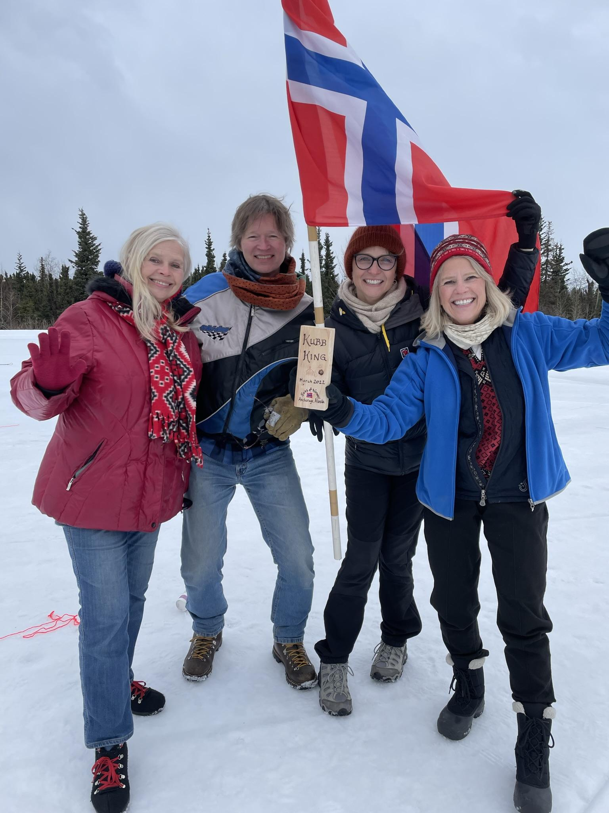
Wrap-Up
Tusen takk!
Website resources at sofn.com
Email questions to fraternal@sofn.com
Thank you for your time and attention

