Slide 1
125th Anniversary of the Sons of Norway
In celebration of the
D5 Sports Challenge:
Exercise your way to Ringsaker, Norway, the site of the 2020 International Sons of Norway Convention, by way of Minneapolis!
In the process, build your stamina and get healthier!

Slide 2
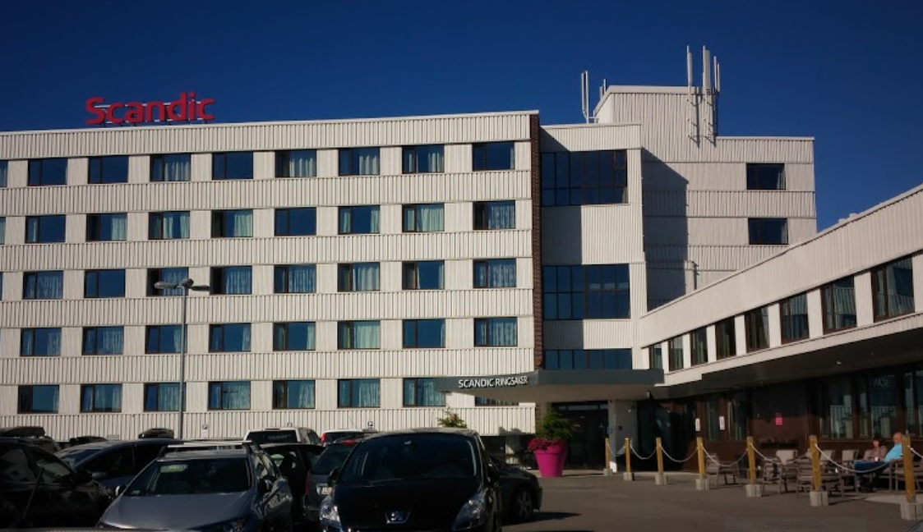
The Scandic Hotel in Ringsaker, Norway had been chosen as the site for the 2020 International Sons of Norway Convention.
Close to Lillehammer, this area of Norway had many things to offer conventioneers.
Like many other things, in 2020, this event was canceled, and soon were all District 1-8 Conventions, as well.
Despite the cancellations, D5 members marched forward with the goal of exercising their way to Norway!

Slide 3
For the Health of It!
Come along with us; it’s Ringsaker or bust!
VIRTUAL WALK TO NORWAY
Embrace Norwegians love of the outdoors!
A lodge’s Sports Director may organize outings for the Lodge participants or individual members may chart their own exercise program.
Members will track their mileage and submit it to their lodge’s Sports Director. They, in turn, will submit the final numbers to the District 5 Sports and Recreation Director by December 15, 2020.
Pictures of the participants will be posted, and the names of their lodge will appear on the District 5 webpage.
Members will receive a certificate of participation in the challenge.
The following lodges accepted the challenge, and their results are shown here.
Flott jobb, allesammen-great job, everyone!

Slide 4
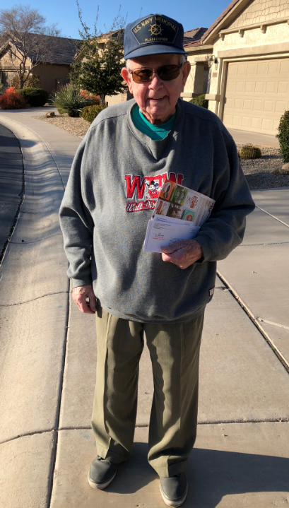
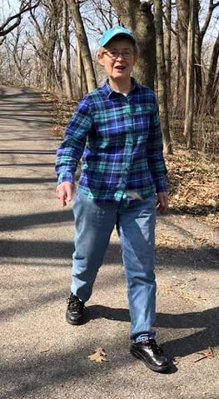
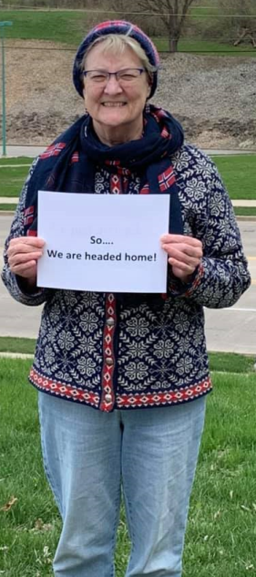
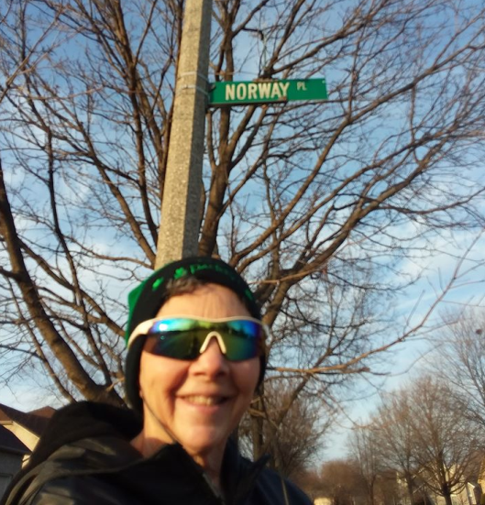
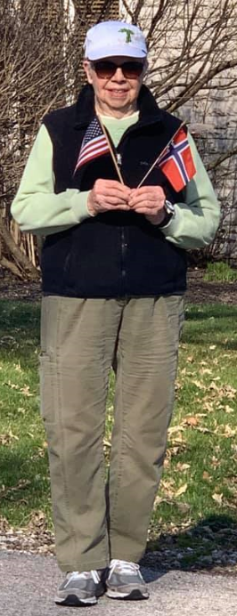
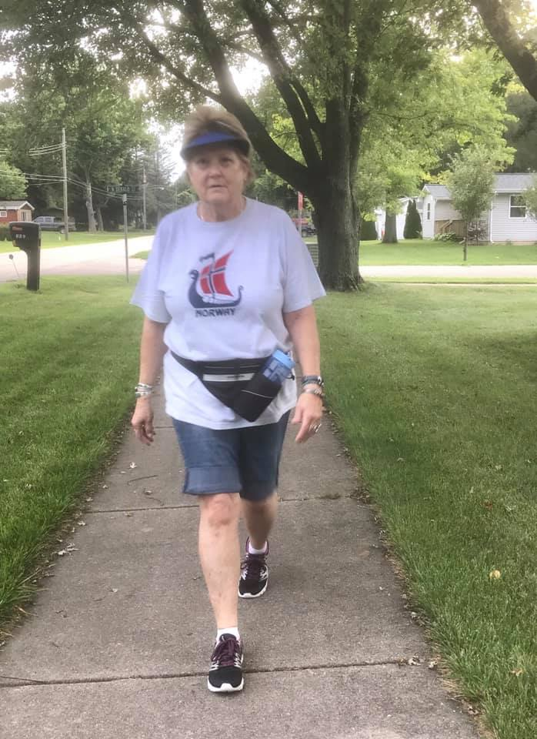
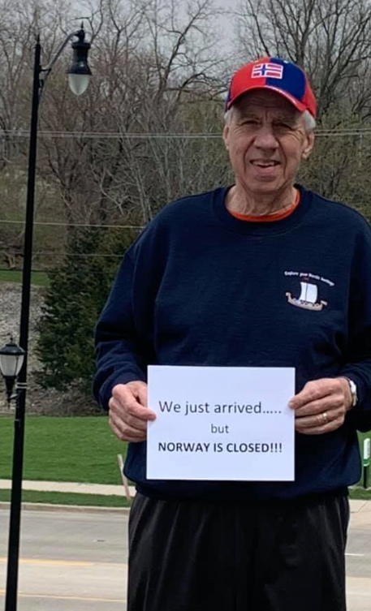
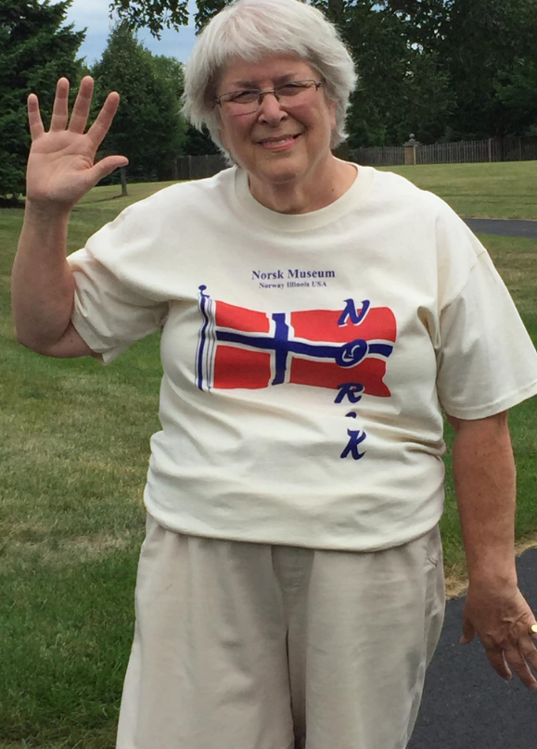
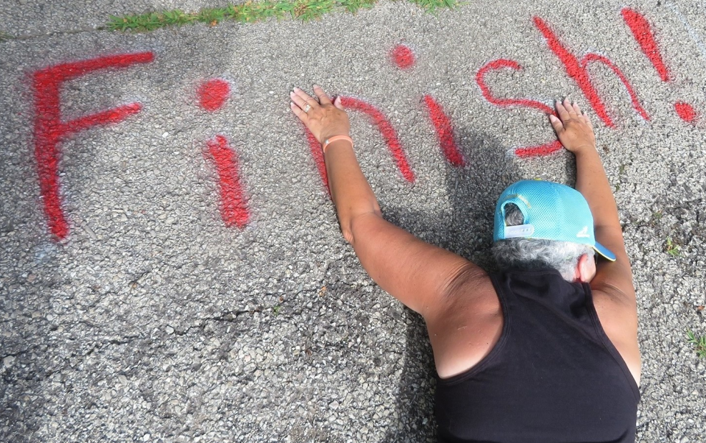
Polar Star Lodge-5-472
Aurora, Illinois
Don Danielson
Nancy Anderson, Social Director
Jerri Lynn Baker,
Sports Director
Barb Johnson
Viola Skogen
Joanie Koehler
Lodge President, Ken Johnson
Karen Oswald

Slide 5
What a dedicated group of athletes! Polar Star members crossed the Atlantic 3 times!
Sports and Recreation Director, Jerri Lynn Baker
Floyd Anderson Tom Harkins Viola Skogen
Nancy Anderson Ed Hatteberg Jim Van Winkle
Jerri Lynn Baker Barb Johnson Carol Vignes
Al Bergh Ken Johnson Richard Vignes
Phoebe Berg Matthew Johnson Kelly Welin
Don Danielson Joanie Koehler
Carol DeVito Frank Krawczyk
Josie Gehler Karen Oswald
Diana Raimond
Polar Star members walked a total of 13,155 miles!

Slide 6
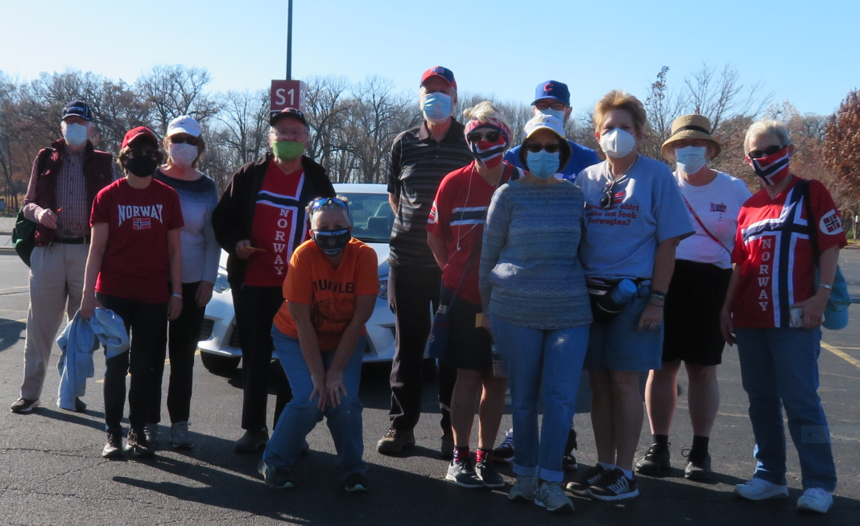
Medal Winners!
Nancy Anderson-Enamel
Jerri Lynn Baker-Idrettshelt twice (following earning all other levels twice)
Al Bergh-Bronze, Silver, and Gold
Phoebe Berg-Gold
Don Danielson-Bronze
Josie Gehler-Silver and Gold
Tom Harkins-Bronze
Barb Johnson-Idretthelt
Ken Johnson-Enamel
Matthew Johnson-Bronze
Joanie Koehler-Bronze, Silver, and Gold
Frank Krawczyk-Idrettshelt
Diana Raimond-Idrettshelt
Viola Skogen-Gold
Carol Vignes-Enamel
Richard Vignes-Bronze, Silver, and Gold
Kelly Welin-Bronze, Silver, Gold, and Enamel
Getting it done for the 5th District!
Way to go, Polar Star Lodge!
Gratulerer til alle!

Slide 7
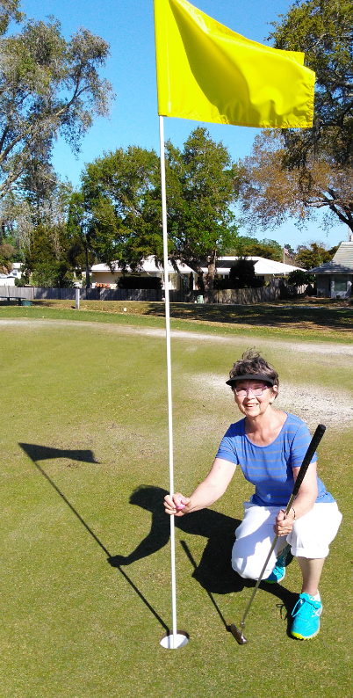
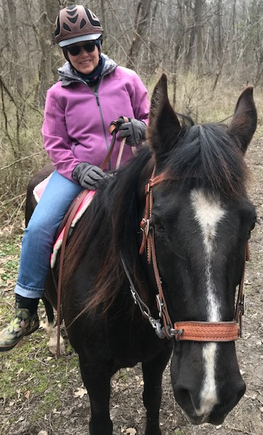
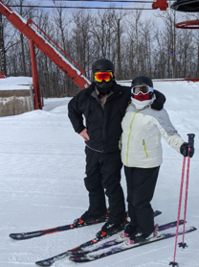
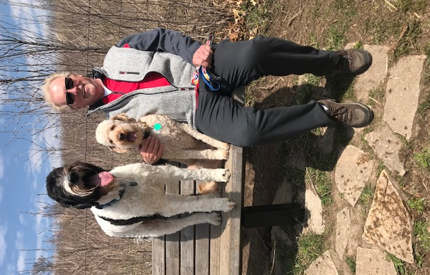
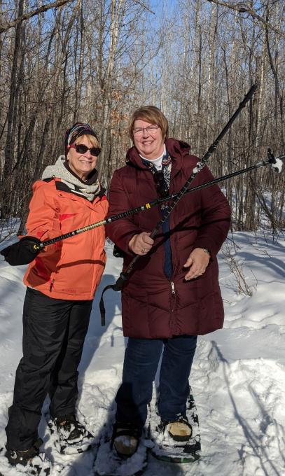
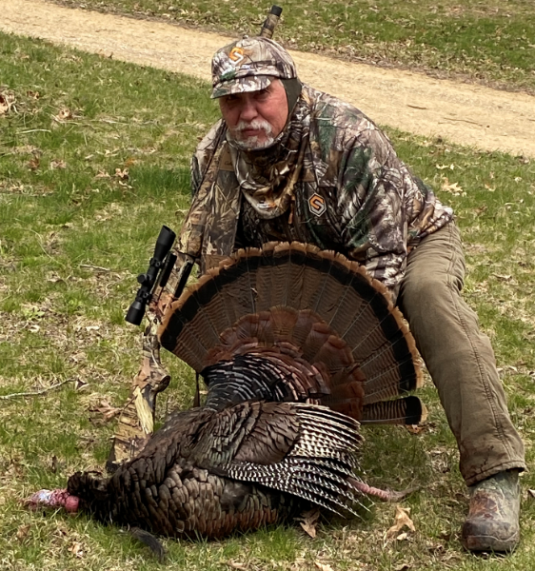
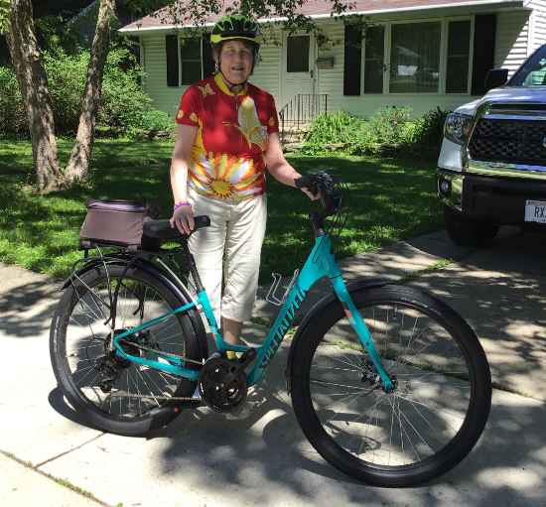
Vennelag Lodge, 5-513 Mt. Horeb, WI
Vennelag President Allen Watrud and friend, Randi, hit the slopes!
Alt for
Norge!
We
did it!
The Troll Capital of the World
Carlyce Skjervem on the trail
Nancy Kittleson having a great time on the links
Arlene Krueger and Cheryl Wille-Schlesser snowshoeing near Hayward, WI
Donna Corcoran takes a break from the bike trail.
Harley Skjervem and boys taking a break at the dog park
John Eberhardt
brought the big Tom down!

Slide 8
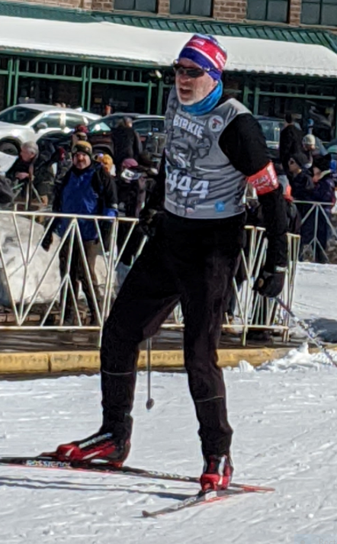
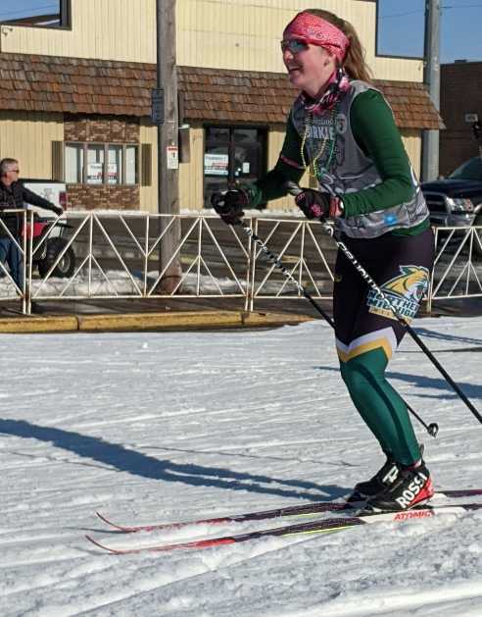
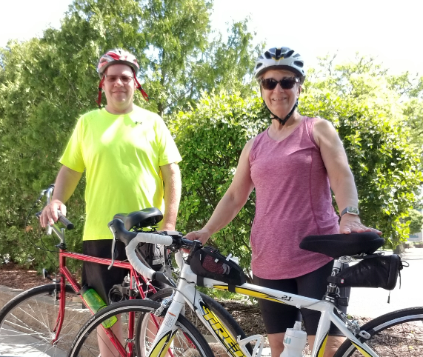
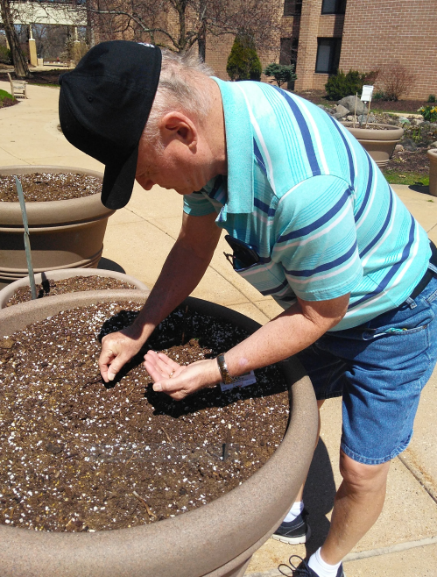
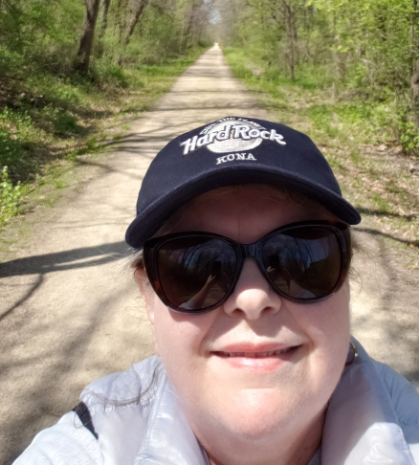
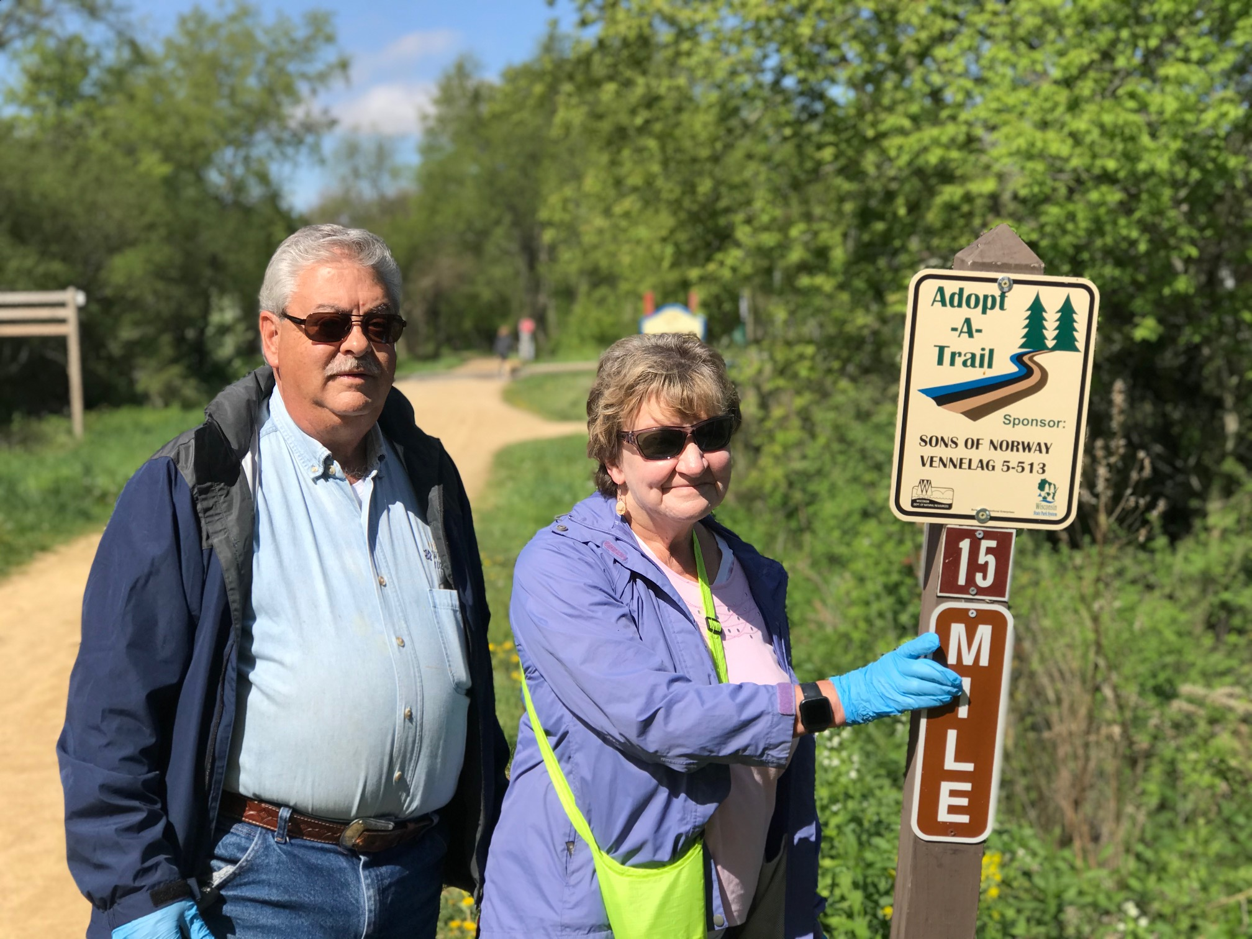
Duane Kittleson is planting his garden pots.
Guy Martin finishes the Classic American Birkebeiner ski race.
Representing Northern Michigan University (and of course, Vennelag Lodge) is Siri Martin.
Aldeen Fjelstad has already earned 3 walking medals, but here she is on the Military Ridge State Trail!
Tom and Kathy Wulff are on trail clean-up.
The pair leads all other walkers in Vennelag Lodge!

Slide 9
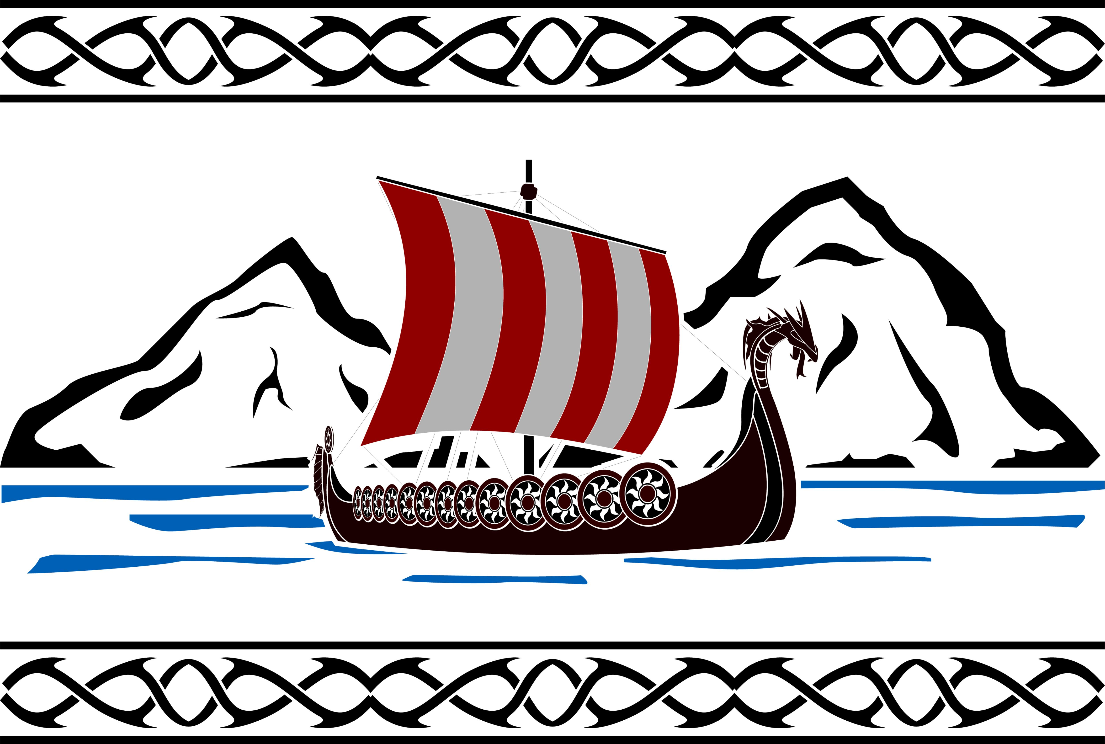
Accomplishments
This lodge worked its way to and from Norway multiple times. In the process, multiple sports medals were earned by the participants.
Those earning sports medals:
Walking
Donna Corcoran-Enamel
Steven Frame-Gold and Enamel
Mark Hanson-Bronze, Silver, Gold, Enamel
Harley Skjervem-Silver, Gold, Enamel
Steven Sopcak-Silver, Gold, Enamel
Arlene Watrud-Krueger-Bronze, Silver, Gold, Enamel
Cheryl Wille-Schlesser-Bronze, Silver, Gold
Skiing
Allen Watrud-Silver, Gold, Enamel
Idrettsmerke
Steven Frame
Total Miles Accumulated: 27,852
Vennelag Participants
Donna Corcoran
John Eberhardt
Aldeen Fjelstad
Steven and Jane Frame
Mark Hanson
Duane and Nancy Kittleson
Guy and Siri Martin
Harley and Carlyce Skjervem
Steve Sopcak
Allen Watrud
Arlene Watrud-Krueger
Cheryl Wille-Schlesser
Tom and Kathy Wulff

Slide 10
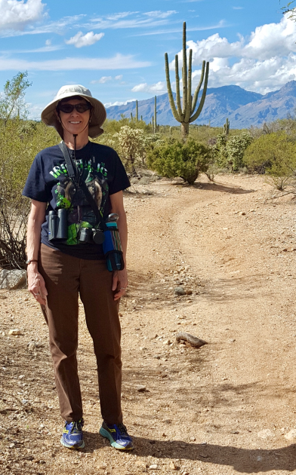
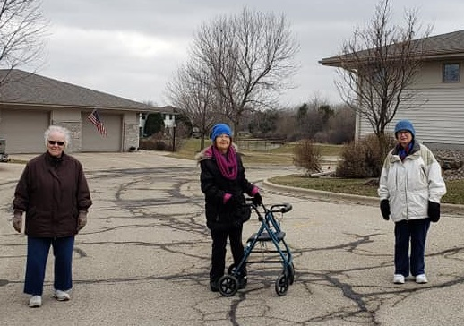
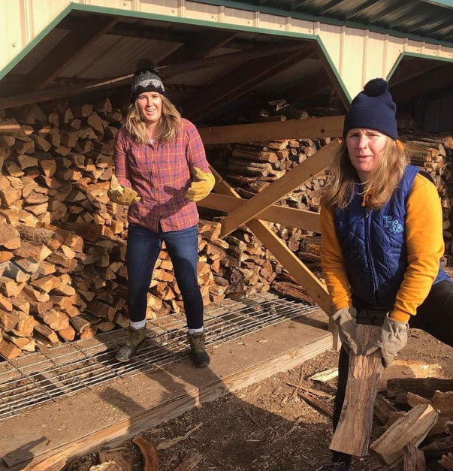
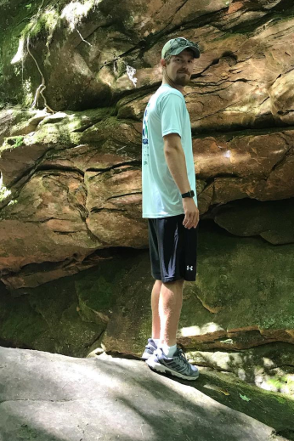
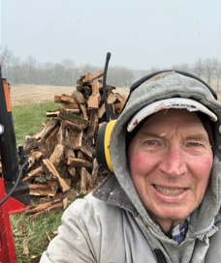
Mandt Lodge 5-314
Stoughton, WI
Marilyn Maurer and her walking buddies
Vonnie Meichtry, hiking in the Sonoran Desert.
Alisha Pleotis and Sigrid Arneson
John Arneson
Jens Arneson out on a hike

Slide 11
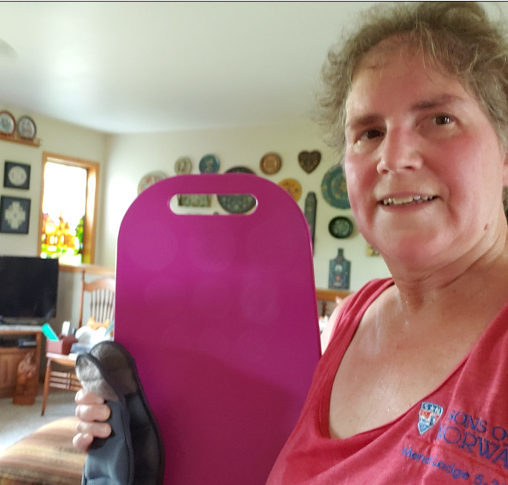
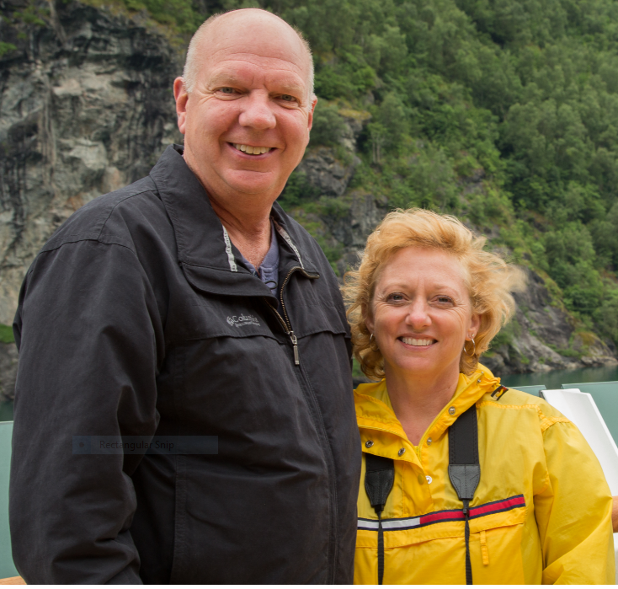
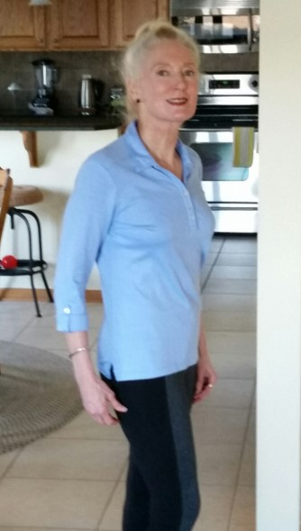
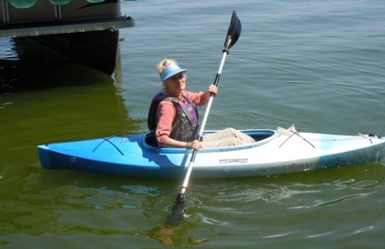
Mandt Lodge Participants
Alan Ciha
Christine Mulligan-Ciha
Christy Tupper
Darlene Arneson
Diane Fossum
Diane Maurer
Greg Haugen
Jane Conner
John Arneson
Karen Haugen
Marilyn Mauer
Pat Boelsing Sigrid Arneson
Todd Fossum
Todd Tupper
Vicky Goplen
Vonnie Meichtry
President Darlene Arneson
With her fitness board and weights
Greg and Karen Haugen, prior to lockdown, cruising the Geiranger Ford.
Christine Milligan- Ciha

Slide 12
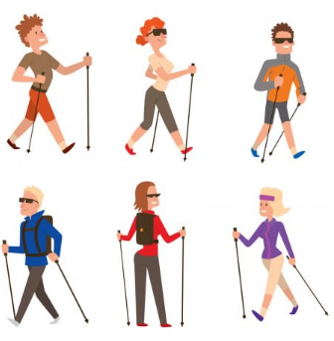
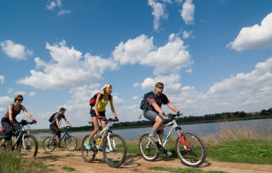
Mandt Sports Medal Winners
Congratulations to these members who will be receiving their medals from lodge sports directors Todd Fossum and Jens Arneson!
Gangmerke (walking)
● Allan Ciha- Bronze, Silver ● Christine Ciha- Bronze, Silver, Gold
● Darlene Arneson- Bronze ● John Arneson- Bronze, Silver ● Jens Arneson- Bronze
● Pat Boelsing- Bronze, Silver, Gold
● Diane Fossum- Bronze ● Todd Fossum- Bronze, Silver
● Vicky Goplen- Bronze
● Greg Haugen- Bronze, Silver ● Karen Haugen- Bronze, Silver
● Vonnie Meichtry- Bronze, Silver
● Christy Tupper- Bronze, Silver
● Todd Tupper- Bronze, Silver, Gold
Sykkelmerke (biking)
● Christine Ciha- Bronze, Silver

Slide 13
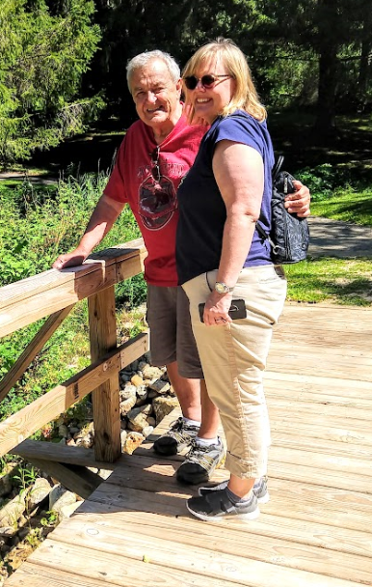
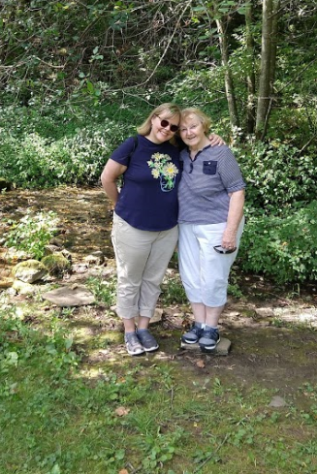
Wergeland Lodge 5-28
La Crosse, WI
Lodge Participants
Carla Burkhardt
Linda Sherwood
Claire Everson
Denise Everson
Kathi Beane
Gary Knudtson
Bev Ranis
Florence Overgard
Ilene Pavelko
Karen Broadhead
Jerome Smith
Dave Glomstad
Al Forde
Julia Forde
Karan Mathison
Tryg Mathison
Darlene Erickson
John Erickson
Carol Stekel
Joe Stekel
Glenn Borreson
Mary Borreson
Laura Ira
Lynn Curtis
Ann Sprain
Dennis Sprain
Adrian Johnson
Ramona Johnson
Carol Pestel
Vivian Sacia
Susan Stekel-Rippley and her father Joe are crossing one of the bridges over Poplar Creek at Norskedalen Nature and Heritage Center near Coon Valley, WI.
Susan Stekel-Rippley and her mother Carol pose by the waterfall created by the High Hopes Springs at Norskedalen Nature and Heritage Center.
Total Mileage: 9,981 miles

Slide 14
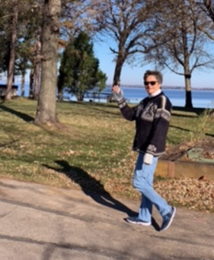
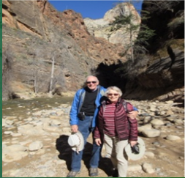
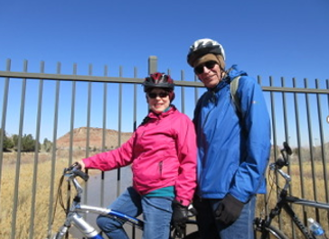
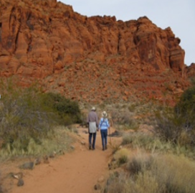
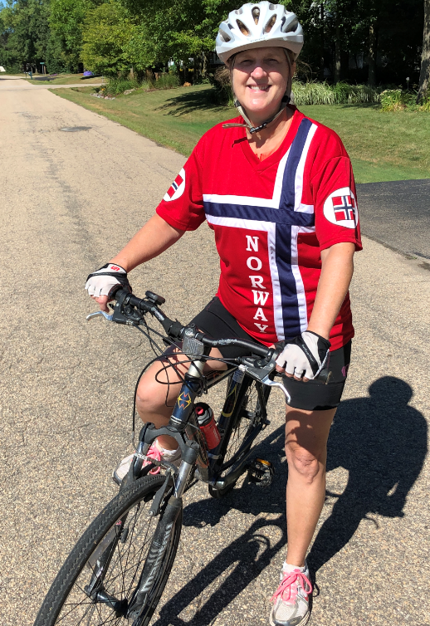
Norse Valley 5-491
Leah and Roger Johnson are getting it done for the 5th District!
Appleton, WI
Lois Gruetzmacher on her mission!
Cyclist Linda Hash

Slide 15
Nordkap 5-378
“The Detroit Norwegians,” Farmington Hills, MI
Sports Challenge Participants
Carmen Collins
Bob Giles
Louise Giles
Karen Herche
Lynn Herche
Carol Jehle
Chet Jehle
Emma Jehle
Cathy Johnson
Greg Morehead
Mary Morehead
Magda Pecsenye
Sue Schotts
Merete Stenerson-Eelnurme
David Thompson
Sports Challenge 2020-Nordkap Lodge
Mileage to Norway: 4,673 miles
Roundtrip: 9,346 miles
Nordkap’s Total Mileage: 10,817
Merete’s Individual Mileage: 12, 439
Nordkaps Total Mileage + Merete’s Mileage: 23,256 miles

Slide 16
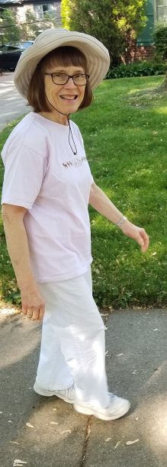
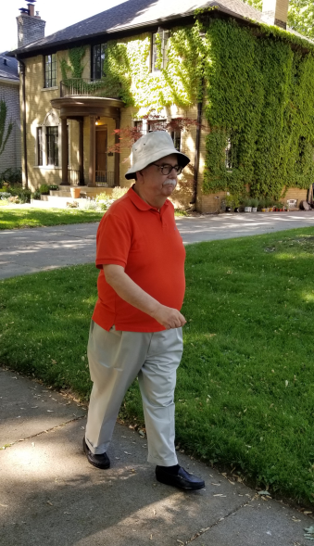
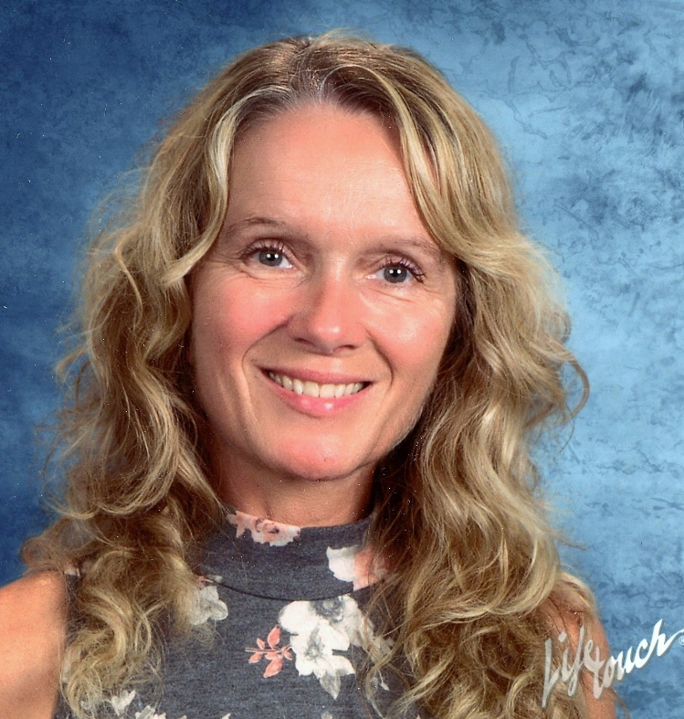
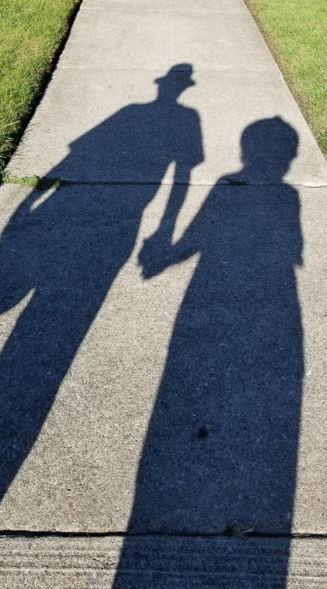
Nordkap Lodge’s Photo Journal of their efforts
Merete Stenerson-Eelnurmen embraces the Norwegian ideal of Friluftsliv-”open air living.” She completed the roundtrip distance to Norway independently. Merete was born and raised in Norway.
Louise and Bob Giles, making tracks to add to Nordkap’s total mileage.
The mystery walkers from the Friendly Fifth Friday News are unveiled-Louise and Bob Giles!

Slide 17
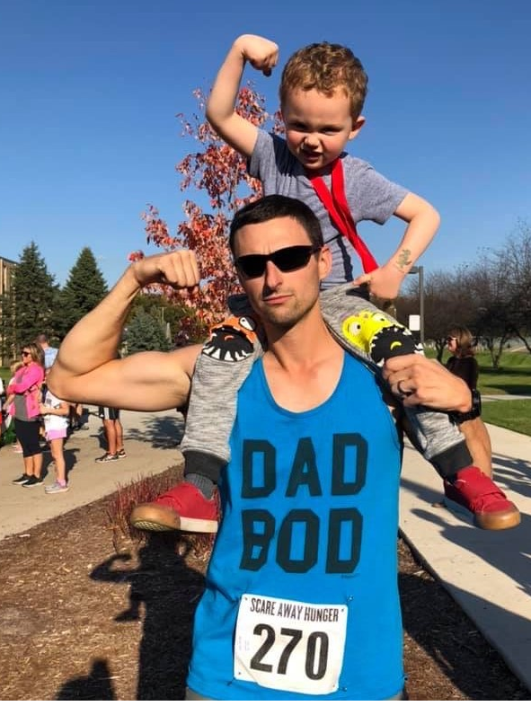
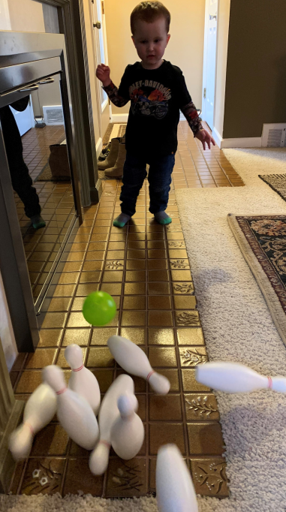
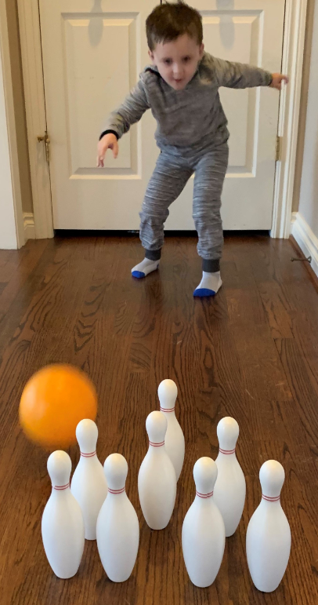
Eli Savage rolling his bowling ball… It’s never too young to begin a healthy lifestyle!
Nice form, James Zawicki!
Greg and Mary Morehead get in on the fun!
Zach and Eli Savage ran a 5K race to “Scare Away Hunger” at Rochester University, Auburn Hills, MI (Eli ran ¼ of a mile) and his dad the full distance on Eli’s 4th birthday. Well done!
WHAT A BOWLER-Point your thumb up toward the ceiling and release the ball!

Slide 18
Valkyrien Lodge 5-53
Total miles walked: 6,526
Distance to Norway 4,036
Participants Walking Medals Earned
Paul Vandersteen B-S-G
Bette Vandersteen B-S-G-E
Randi Hoffman B-S
Ron Thompson B-S
Clair Severson B
Don Olson
Greg Warner
Sandra Olson
Audrey Severson
Carol Forsythe
Einar Sandom
Mary Lestrud
B-Bronze S-Silver G-Gold E-Enamel
Woodville, WI
President Audrey Severson reports 6,526 miles were walked by her members during the Virtual Walk Challenge!

Slide 19
Grønnvik Lodge 5-632
Green Bay, WI
Grønnvik participants included:
Matthew Agen (B,S,G,E)
Nelson Agen (B,S,G,E,I)
Eileen Larson Below
Darlene Gast (B)
Alaina Hepp
Erik Hepp
Karen Hepp
Kathy Romsos (B,S,G,E)
David Running (B,S,G,E)
Rita Running (B,S,G)
Peggy Schroeder
Gangmerke medals include: Bronze (B), Silver (S), Gold (G), Enamel (E), and Idrettshelt (I).
Grønnvik Lodge traveled 4,776 miles and was able to reach Ringsaker, Norway (the goal was 4,262 miles). “It took us awhile, but we made it,” reports Sports and Recreation Director-Matthew Agen.
Lodge members Dave and Rita Running are making tracks through the snow during the 5th District’s Virtual Walk to Norway challenge.

Slide 20
Edvard Grieg Lodge 5-657
Cincinnati, OH
Distance from Cincinnati to Minneapolis: 703 miles
Minneapolis to Ringsaker, Norway 3,984 miles
Mileage Needed: 4,687 miles
Total miles submitted: 5,268 miles
Susan Herman meets some furry friends and takes a break from walking
Jim Herman, Edvard Grieg Lodge’s President is prepared to hit the pavement wearing his Syttende Mai ribbon.
Raymond Sonoff and Elisabeth Pettersen-Sonoff also participated. Takk for hjelpen!

Slide 21
Valhall Lodge 5-168
Rockford, Illinois
Number of miles from the location where your lodge meets to Minneapolis, MN 334
Number of miles from Minneapolis, MN to Ringsaker, Norway + 3,984
TOTAL MILES = 4,318 Valhall Members’ Miles…
Wendy Higgins 867.5 miles
Christina Fairchild–601.74 miles
Richard Fairchild - 601.74 miles
Patricia Farney – 539 Miles
Linda Peterson – 442 miles
Robert Schrober – 396.934 mile
Isabel LaPonsie– 55.4
Sandy Carter – 52.5 miles
Valhall lodge accumulated: 3,575 miles
Gangamerke Medals Earned:
Wendy Higgins – Idrettshelt pin
Christina Fairchild - Enamel pin
Robert Schrober – Bronze and Silver pin
Valhall’s youngest participant
Our journey will continue !

Slide 22
Askeladden Lodge 5-610 Kalamazoo, MI
Askeladden Lodge’s Sports and Recreation Director Curt Osborn reported that their members have exercised a total of 2,812.3 miles. Four people participated but it was Alt for Norge! The youngest participating member is 67 years old.
The miles are an accumulation of walking, stationary bicycling, and road cycling.
Flott jobb, Askeladden Lodge members! Keeping members active was one of our goals☺

Slide 23
Askeladden Participants
The members that participated are:
Gail Hadley
Teri Koretski
Joyce Hare
Beverly Osborn
Curt Osborn

