Slide 1

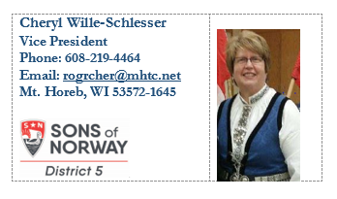
A Guide for DISTRICT LEADERS
An overview for your lodge members
Applicable for a new member event
Cheryl Wille-Schlesser
District 5 Vice President

Slide 2



Velkommen!
Some lodges make brief announcements at the beginning of a meeting.
Guests and new members are recognized. Please let your president know, if you have brought a guest before the meeting begins.
The National Anthems are sung.
*Canada
*Norway
*The United States of America
Membership Totals
March 31, 2021 – total membership is 54,283 – including heritage and financial benefits members in three countries.

Slide 3
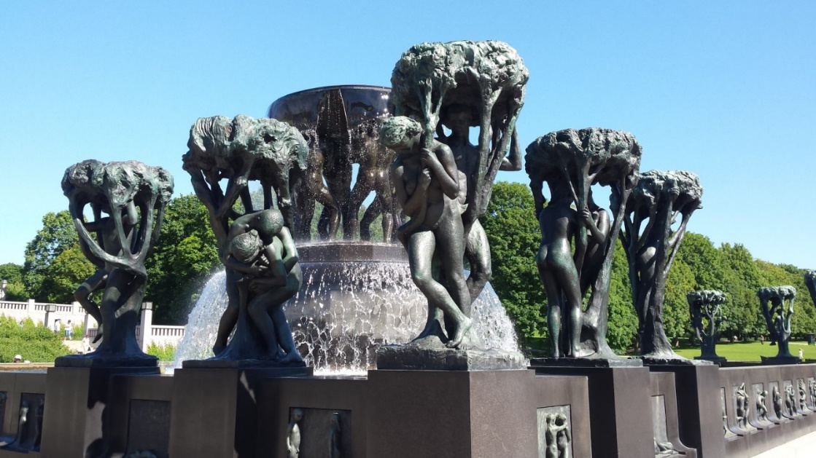
MYSTERIOUS NORWAY
Get your members talking by playing a game of mysterious Norway or choose another activity.
For mysterious Norway, select photos of well-known places in Norway.
Ask participants to pair together and try to identify the locations you have chosen.
Then share the results with the assembly.

Slide 4

DISTRICT 5 CONVENTION, 2022
Madison Marriott West
Middleton, WI
June 15-18
(adjacent city to Madison, WI)
1313 John Q. Hammons Drive
Middleton, WI 53562
Contact Lucy Ghastin, Convention Chair, for further information:
email: leghastin@gmail.com

Slide 5


Zone Directors…Get your District 5 Logo!
Lodge Presidents can request their logo, too.
Perfect for Lodge correspondence
Advertising
Lodge brochures and other signage
Contact the International Office,
800-945-8851, for further assistance.

Slide 6
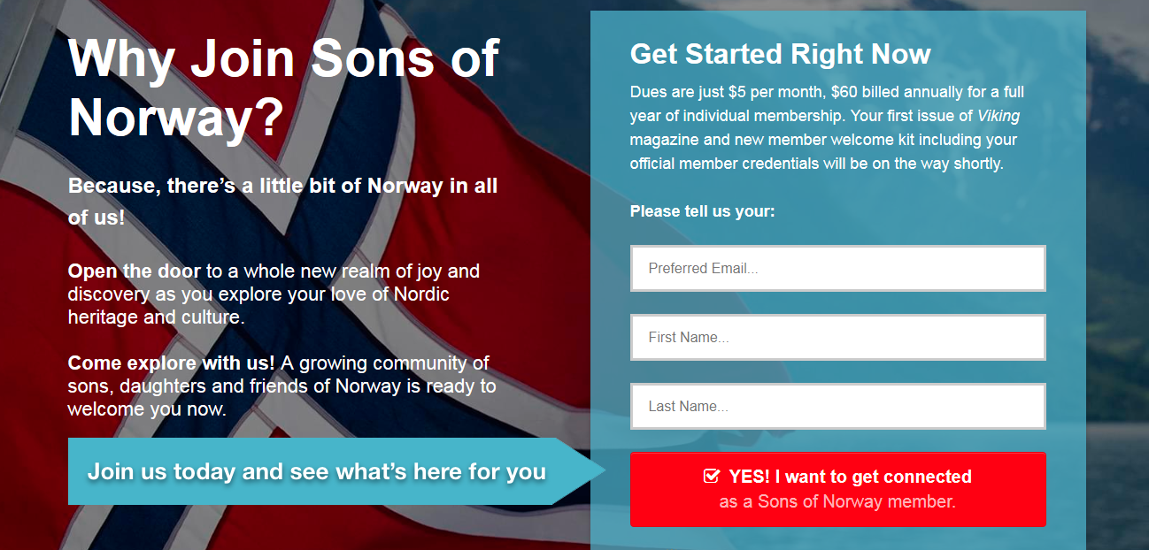
THE SONS OF NORWAY INTERNATIONAL WEBSITE
For more information:
www.sofn.com with your username and password.
To find what you are seeking use the magnifying glass icon and type-in the information you seek.

Slide 7
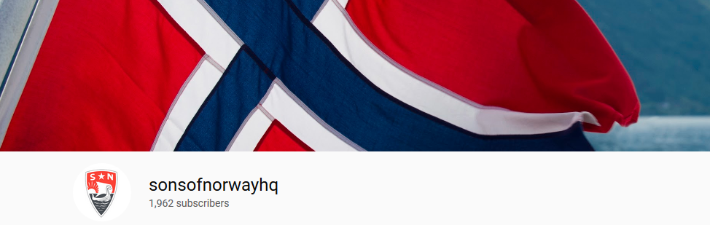
HEADQUARTERS HAS MUCH INFORMATION THAT IS HELPFUL AND THERE ARE TRAINING VIDEOS: www.sonsofnorwayhq-YouTube
*FUN INFORMATION *CULTURAL SKILLS UNITS
*HISTORY *FINANCIAL: life insurance, annuities
*MUSIC PLAYLISTS *SYTTENDE MAI and other Lodge programming ideas
*POST A LOCAL LODGE EVENT * CATCH-UP ON THE LATEST NEWS FROM NORWAY-BLOG

Slide 8

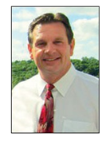
FINANCIAL OPTIONS IN AN UNCERTAIN WORLD
Contact the home office to discover which Insurance Professional (IP) has been assigned to your lodge.
If your lodge is in Michigan, Tennessee or Ohio, investments remain an option for your members. Contact an IP to discover how you may invest in a Sons of Norway benefit product.
Greg Ragan
Phone: (815) 623-8817 E-mail: www.gregragan.com

Slide 9
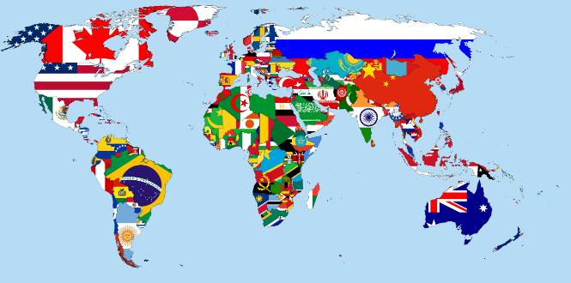
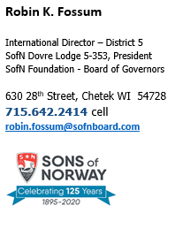
Please call Robin with any questions or concerns you may have about the Sons of Norway Foundation or the workings of the International Board of Directors.

Slide 10
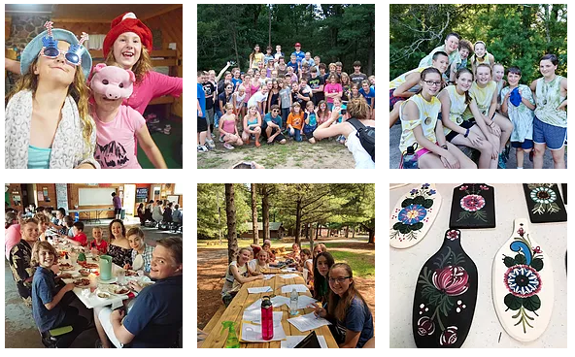


Sandra Olson, Youth Director
Acting Masse Moro Administrator
Sons of Norway – District 5
733 250th Street
Woodville, WI 54028
(651) 208-3333
packerland@baldwin-telecom.net
A heritage experience for youth ages 9-15
SCHOLARSHIPS are available.

Slide 11
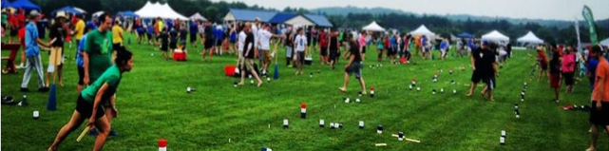
Sports and Recreation Options for the 5h District
Audrey Severson is the Sports and Recreation Director for the 5th District.
She has overseen the Barnebirkie and welcomes your ideas for Districtwide sports challenges!
Local lodge Sports and Recreation Directors should use the season of the year to challenge their members. Help your members to stay healthy by providing options.
Many lodges participated in Friluftsliv events “outdoor living” in 2020.
Members earned sports pins through their participation. More than 145 people joined the Virtual Walk to Norway challenge.
A personal bonus for all members is the opportunity to improve one’s health.
Audrey Severson apseverson@gmail.com
A great family sport, kubb!

Slide 12
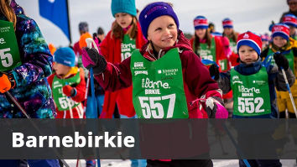
ALL ABOARD FOR THE BARNEBIRKIE!
NEARLY 1,000 YOUTH SKIERS
HUNDREDS OF DOZENS OF COOKIES ARE PROVIDED.
CHILDREN BEGIN SKIING AT 2.5 YEARS OLD.
A SKI RACE LIKE NO OTHER!
JOIN US IN HAYWARD, WI, FOR THIS GREAT EVENT, THE THIRD WEEKEND OF FEBRUARY EACH YEAR!
THANK YOU, DISTRICT 5 VOLUNTEERS!
YOUR HELP IS GENUINELY APPRECIATED.
YOUR COOKIES ARE LEGENDARY!

Slide 13
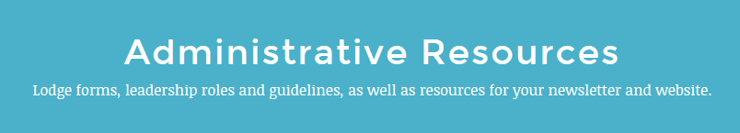
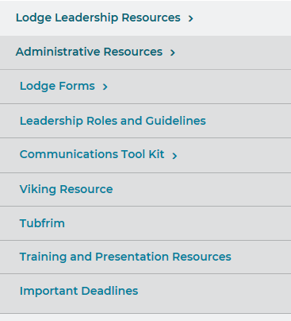

ALSO AVAILABLE…
TRAINING VIDEOS
www.sofn.com

Slide 14
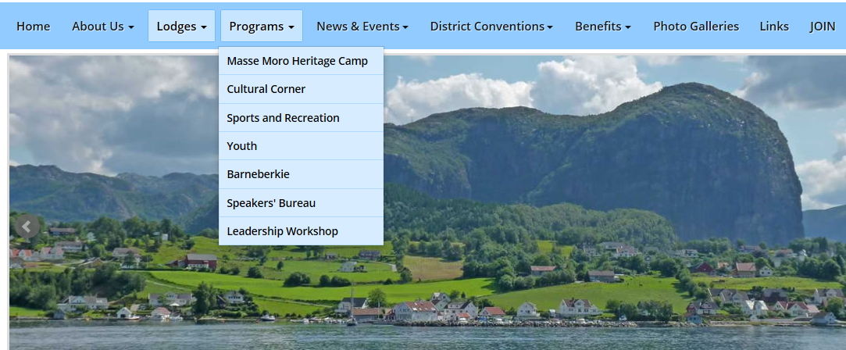
NEED A SPEAKER?
CHECK THE D5 SPEAKERS’ BUREAU!
Search: www.sonsofnorway5.com

Slide 15

WE MAKE A DIFFERENCE!
IDENTIFY THE COMMUNITY SERVICE PROJECTS YOUR LODGE HAS ENDORSED.

Slide 16
SONS OF NORWAY RESOURCE
A TOOL FOR LOCAL LEADERS
*EMAILED TO LOCAL LODGE LEADERS
*CONTAINS UPDATED INFORMATION ON A VARIETY OF SUBECTS SUCH AS: MEMBERSHIP, THE FOUNDATION, AND LODGE REQUIREMENTS.

Slide 17
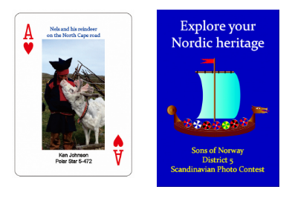
The 5TH District Treasurer has designed and ordered a variety of merchandise which is for sale and benefits the District’s coffers.
*apparel *books *aprons *hats
*Books written on heritage topics.
*Scandinavian playing cards *Norwegian flags
Contact Michael Palecek:
mikep@sonsofnorwayracine.com

Slide 18
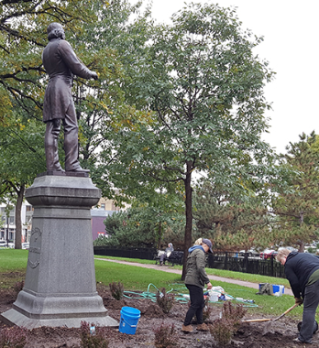
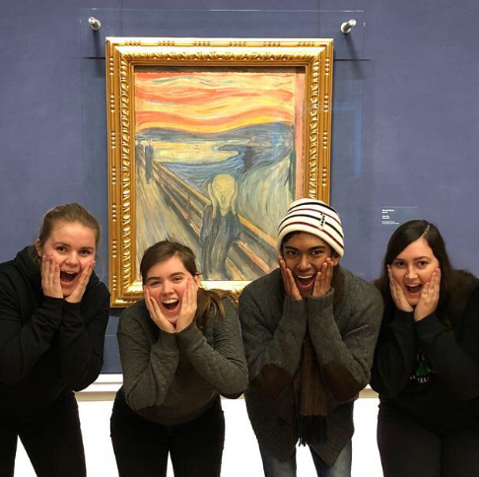
TOOLS FOR MEMBERSHIP RECRUITMENT
*SCHOLARSHIPS *FELLOWSHIP *DISTRICT MERCHANDISE
*OPPORTUNITIES FOR VOLUNTEERISM *FUN!
*PERKSPOT-Exclusive discounts and perks
*SONS OF NORWAY BLOG Today’s News

Slide 19
REVITALIZATION OF A LODGE
1) Ask your Zone Directors or District Officers for assistance.
2) Fill out an interest inventory-what do members want to learn or do?
3) Plan an event to bring your lodge into the limelight.
4) Partake in a community event.
5) Apply for a Lodge Revitalization Grant.
6) Meet with your leaders to chart the future.

